Slide 1
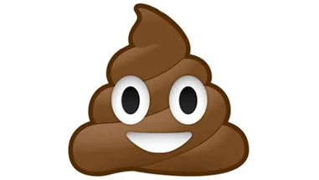
Poo quiz

Slide 2
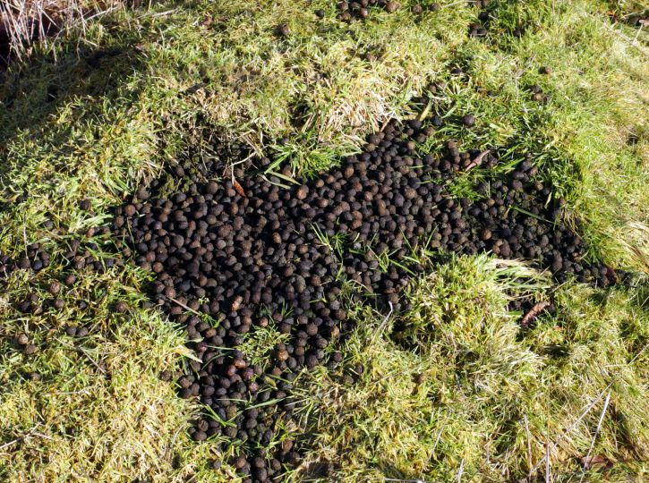
Who did this poo?
Fox
Rabbit
Hedgehog
Badger

Slide 3
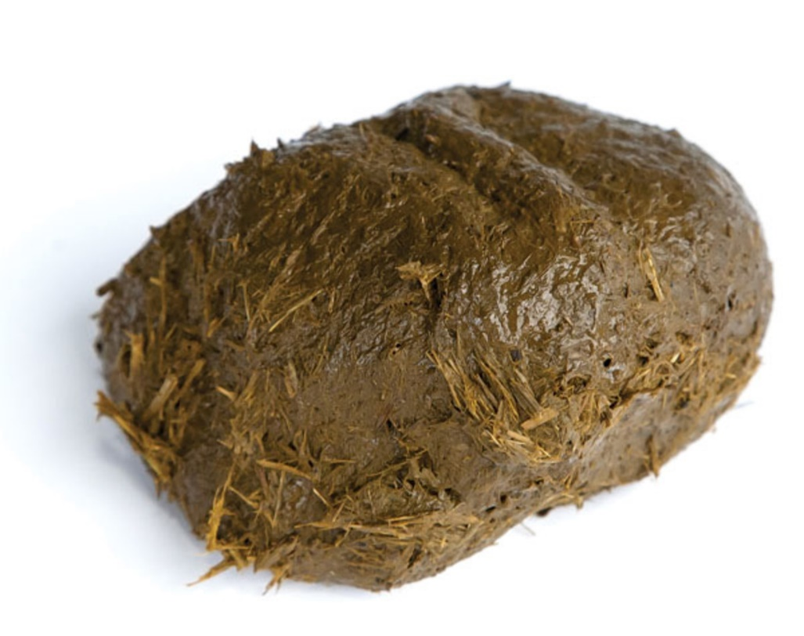
Who did this poo? Carnivore or Herbivore?
Carnivore
Herbivore

Slide 4
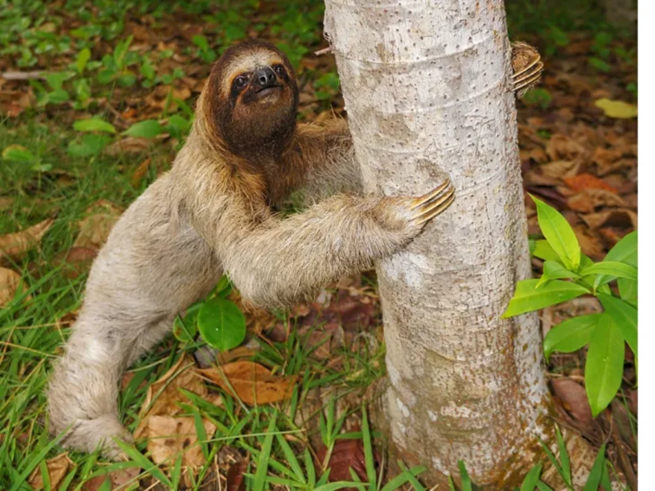
What do sloths do before doing a poo?
Sing
Read a paper
Cry
Dance

Slide 5
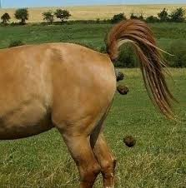
What is another name for horse poo?
Castings
Spraints
Fewmets
Dung

Slide 6
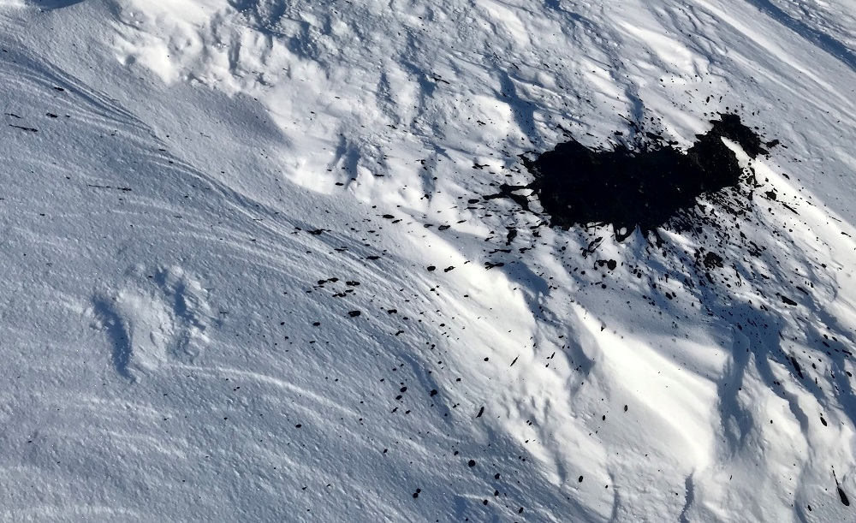
Which animal did this?
Seal
Arctic Hare
Polar bear
Moose

Slide 7
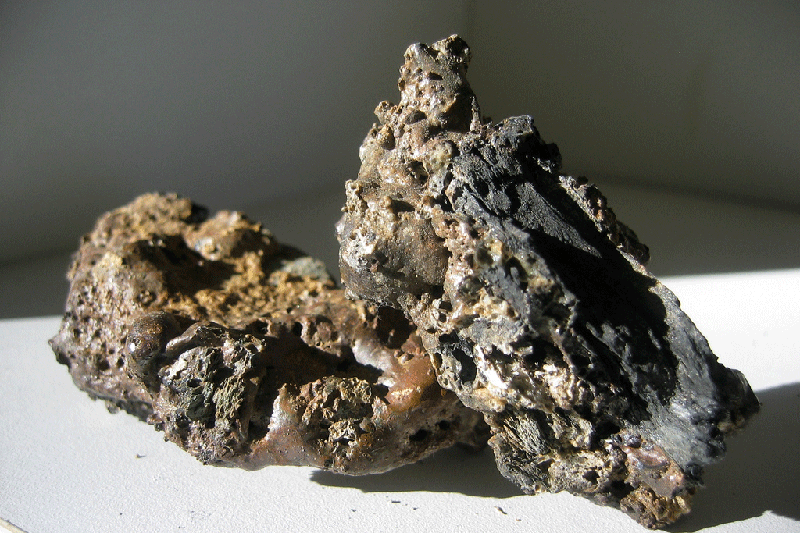
What are fossilized poos called?
Coprolites
Geodes
Stalagmites
Guano

Slide 8
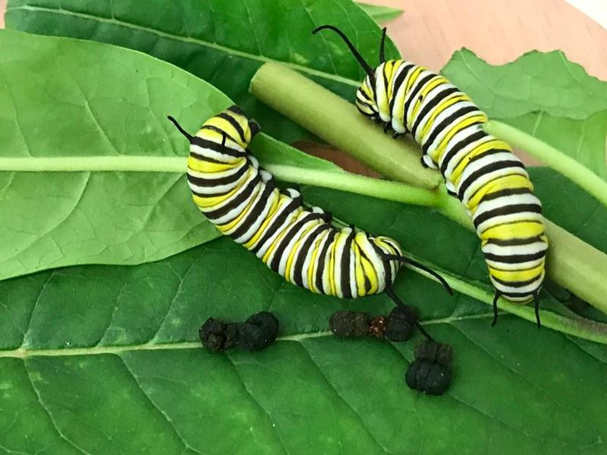
What is caterpillar poo called?
Clods
Guano
Frass
Coprolites

Slide 9
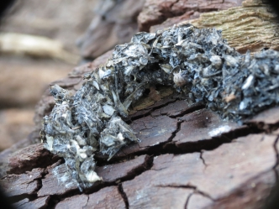
Who did this poo?
Hare
Squirrel
Otter
Hedgehog

Slide 10
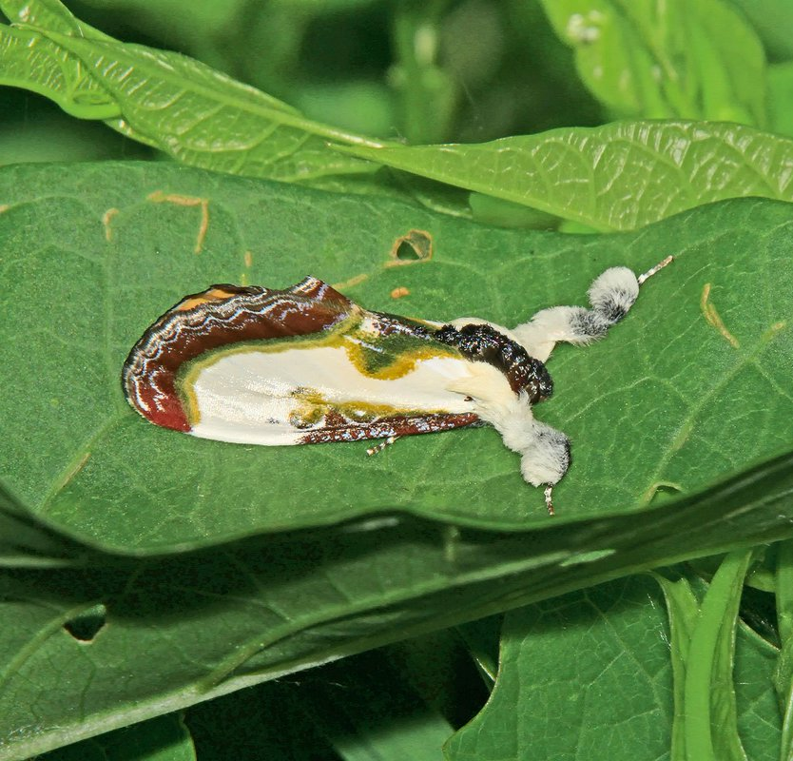
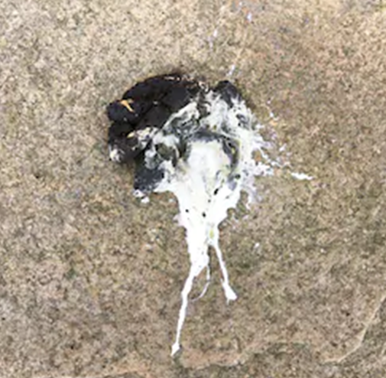
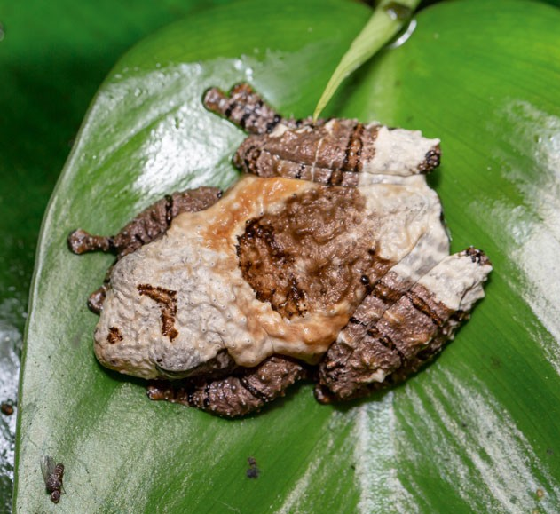
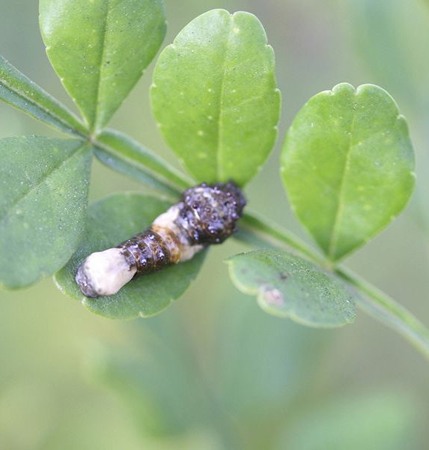
Which of these are not bird poo?
A
B
C
D
A
B
C
D

Slide 11
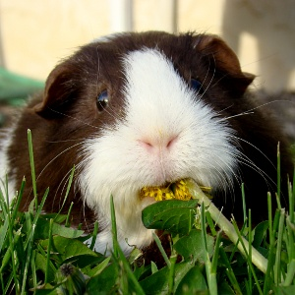
Why do Guinea Pigs eat some of their poo?
To avoid looking for food
To keep their nests clean
To attract a mate
To get vitamins

Slide 12
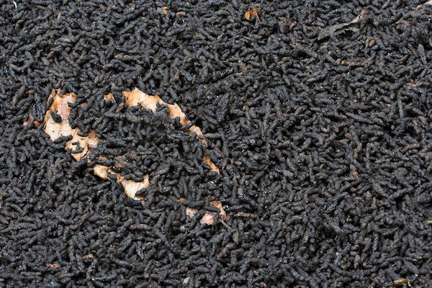
What used to be made from bat poo?
Decorations
Explosives
Roads
Fuel

Slide 13
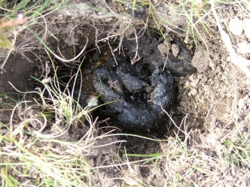
Who did this poo?
Otter
Fox
Deer
Badger

Slide 14
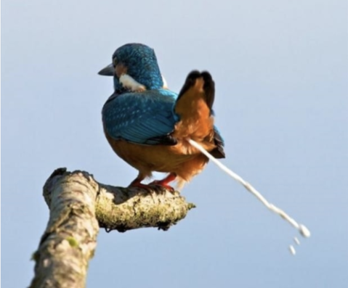
What colour car attracts the most bird poo?
Red
Blue
White
Green

Slide 15
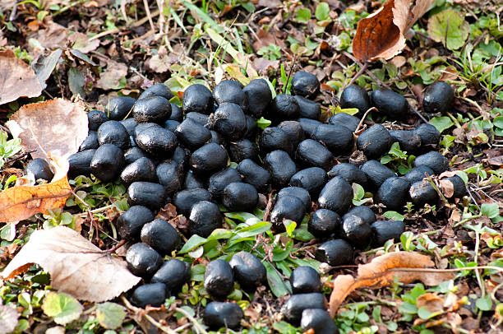
Who did this poo?
Deer
Otter
Fox
Hedgehog

Slide 16
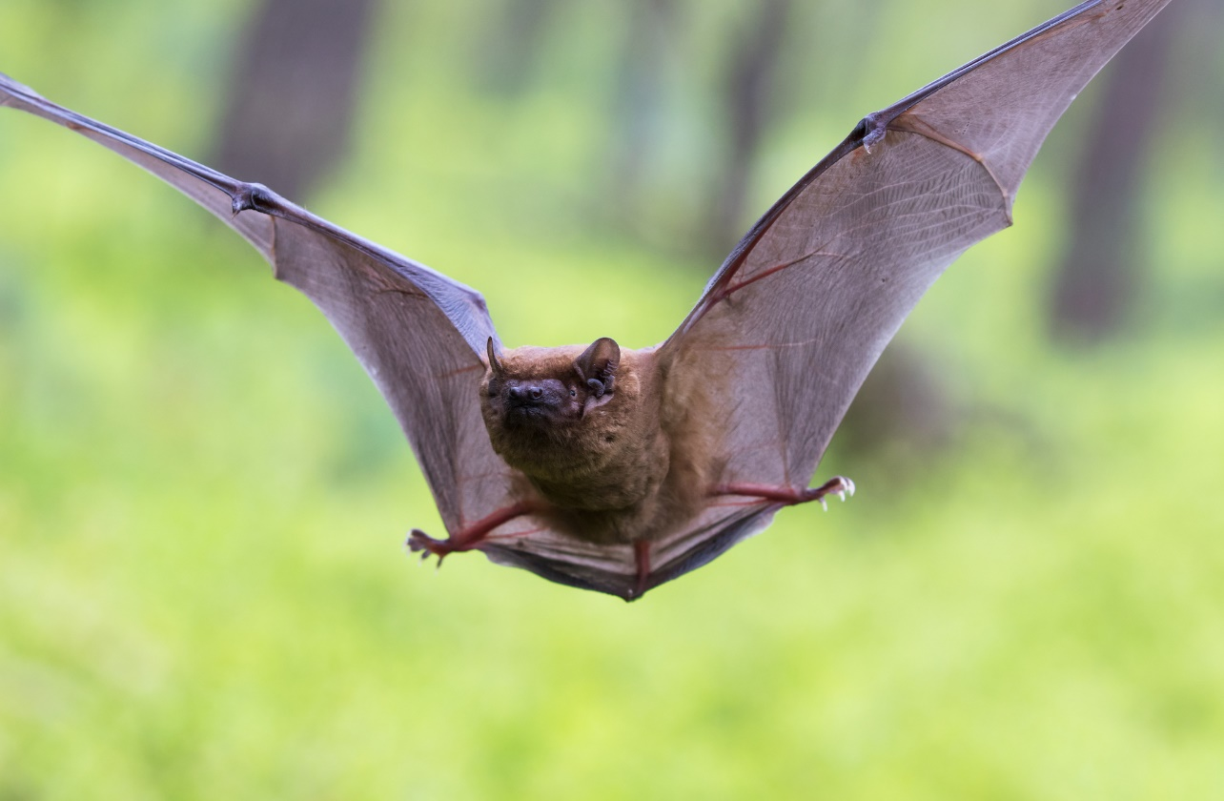
What is another name for bat poo?
Boo
Guano
Kannaki
Dung

Slide 17
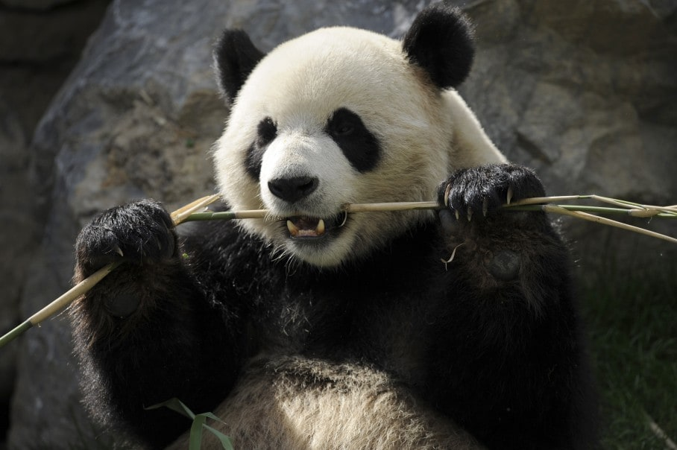
On average how many times a day does a panda poop?
10
20
30
40

Slide 18
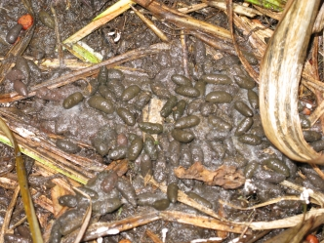
Who did this poo?
Rabbit
Water vole
Otter
Deer

Slide 19
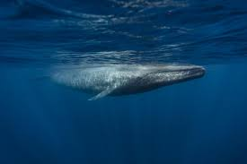
What colour is Blue Whale poo?
Red
Blue
Brown
Green

Slide 20
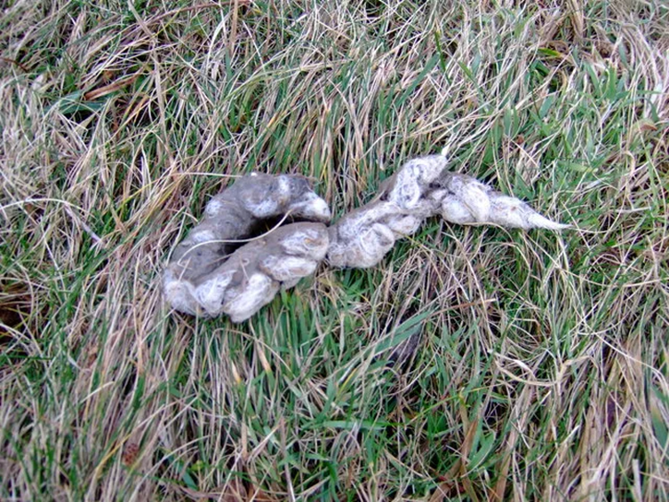
Who did this poo? Carnivore or Herbivore?
Carnivore
Herbivore

Slide 21
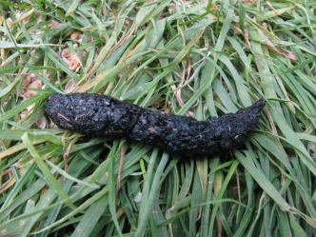
Who did this poo?
Hedgehog
Squirrel
Otter
Fox

Slide 22
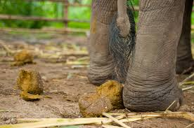
One day’s Elephant poo weighs the same as..?
1 Cub
2 Cubs
3 Cubs
4 Cubs

Slide 23
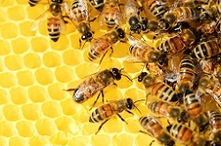
Is honey made from bee poo?
Yes
No

Slide 24
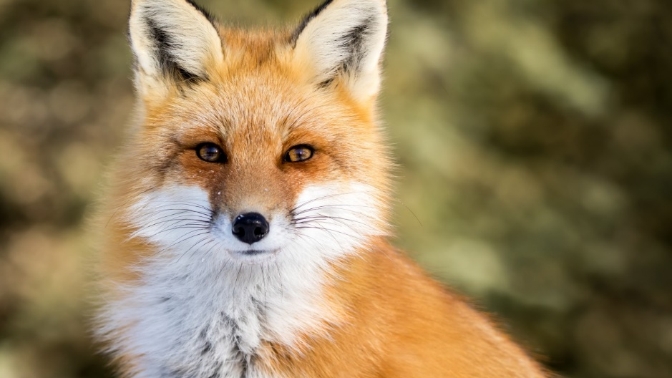
What is another name for fox poo?
Castings
Spraints
Fewmets
Dung

Slide 25
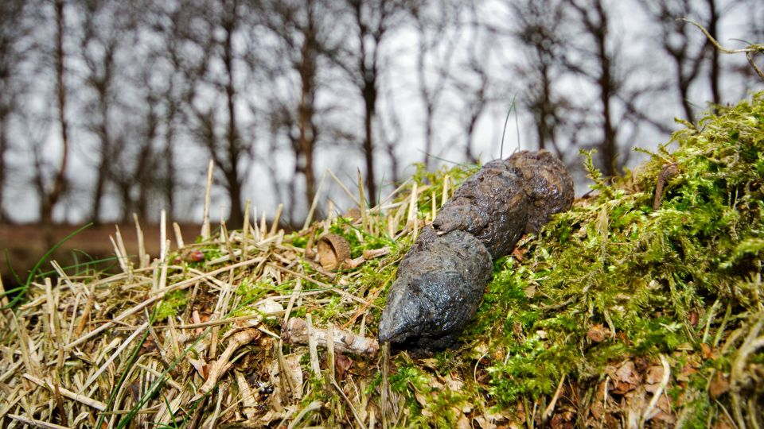
Who did this poo?
Hare
Squirrel
Hedgehog
Fox

Slide 26
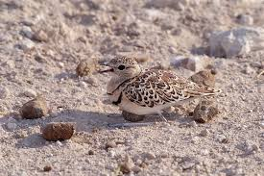
Why does the Double-banded courser make it’s nest near poo?
To disguise egg from predators
It likes the smell
Food source for it’s chick
To attract insects

Slide 27
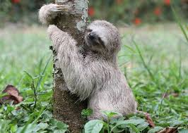
How often does a sloth poop?
Every day
Every 2-3 days
Every 7-10 days
Once a month

Slide 28
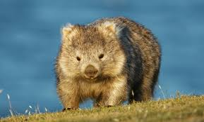
What shape is a Wombat’s poo?
Flat like a pancake
Cylindrical like a sausage
Round like a ball
Cubed like a dice

Slide 29
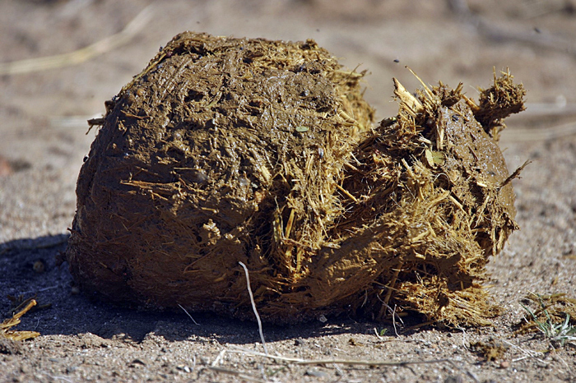
What is regularly made from Elephant poo?
Perfume
Paper
Candles
Explosives

Slide 30
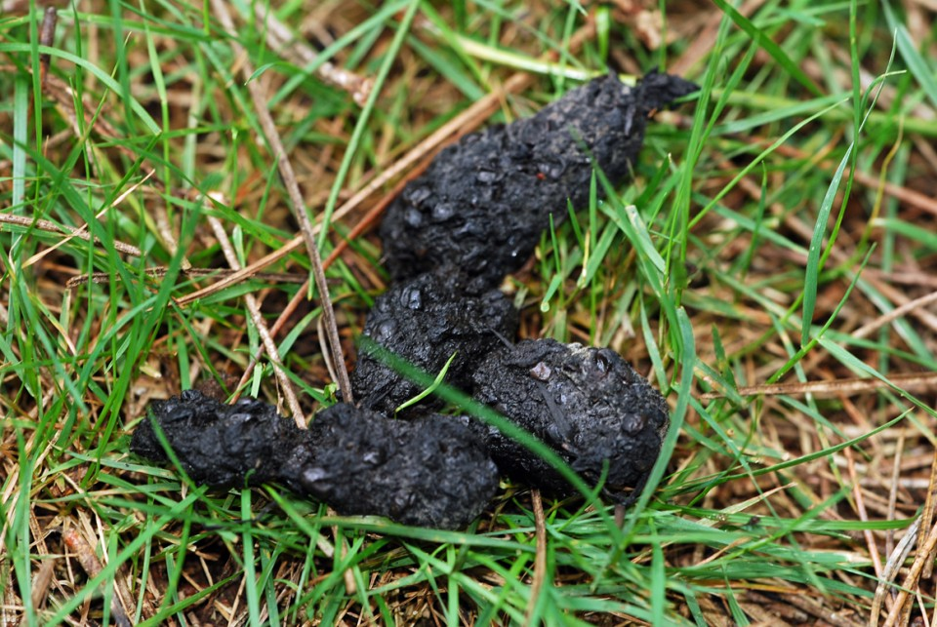
In what season was this fox poo found?
Spring
Summer
Autumn
Winter

Slide 31
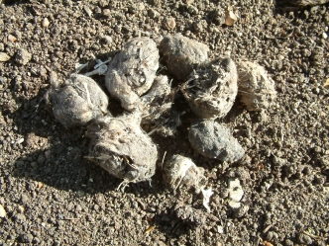
Are Owl pellets poo?
Yes
No

Slide 32
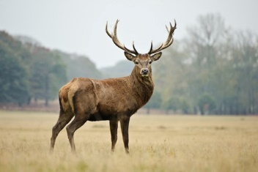
What is another name for deer poo?
Castings
Spraints
Fewmets
Dung

Slide 33
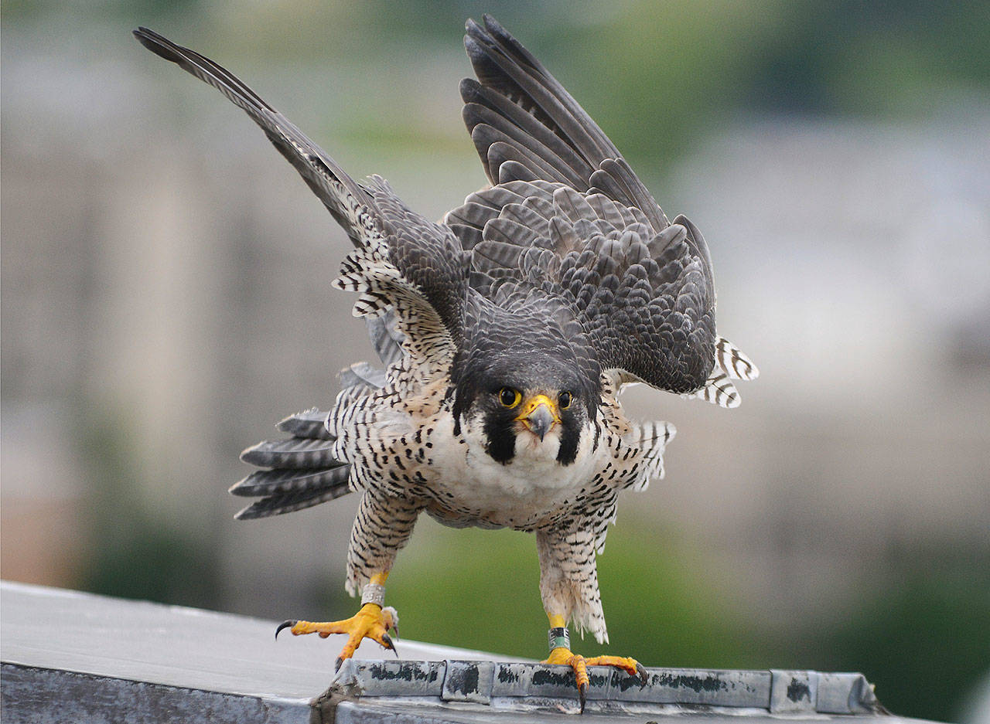
Why does a Peregrine Falcon poo before flying?
To scare their prey
To make themselves lighter
To mark their territory
For luck

Slide 34
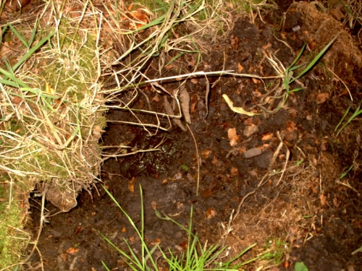
Which of these digs a hole called a latrine for it’s poo?
Badger
Rabbit
Fox
Mole

Slide 35
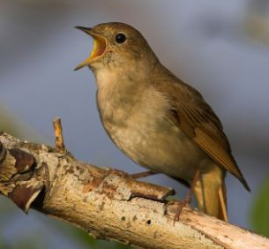
In Japan, Nightingale poo is used for what?
Glue
Hair dye
Face cream
Paint

Slide 36
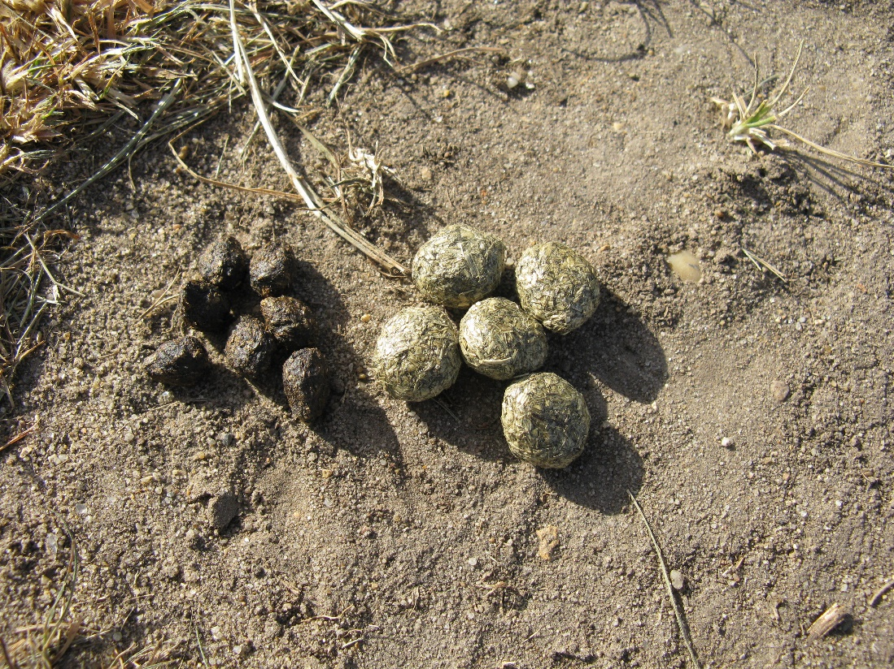
Who does the bigger poo, Rabbit or Hare?
Rabbit
Hare

Slide 37
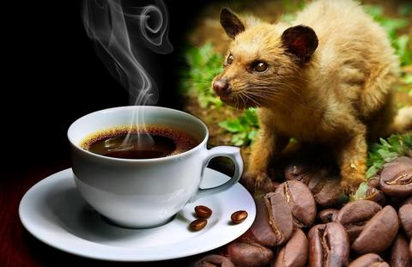
Kopi luwak coffee is made from Civet poo. How much does it cost for 1 cup?
25p
£2.50
£25
£250

Slide 38
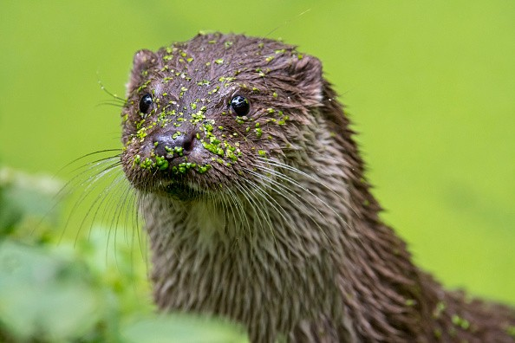
What is another name for otter poo?
Castings
Spraints
Fewmets
Dung

Slide 39
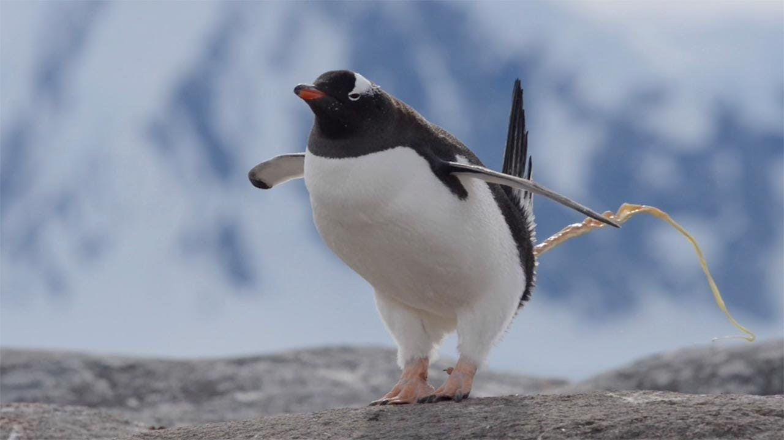
How far can a penguin fire its poo?
10 cm
40 cm
100 cm
140 cm

Slide 40
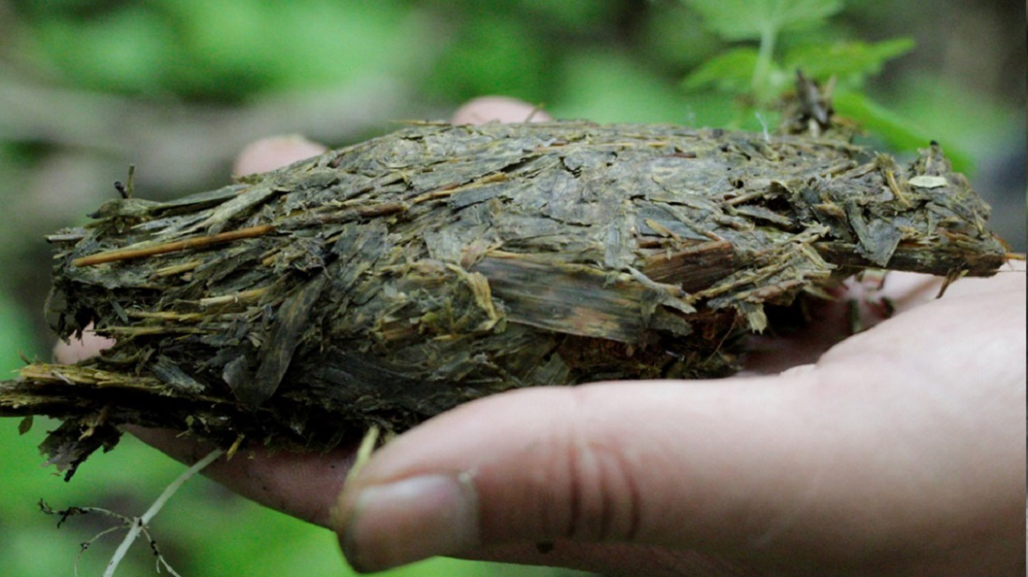
Which animal did this?
Lion
Tiger
Panda
Akela

Slide 41
The End

