Slide 1
BEAVERS
CODE CRACKING
MYSTERY!!!

Slide 2
Detective Agency

Slide 3
The Case
Boo has been kidnapped again!
However, she has managed to leave
some messages to
help us identify
who has taken her.
KIDNAPPED !!!

Slide 4
These messages have been passed to the Detective Agency
It seems that some of these
messages have been written in code to stop the kidnapper reading them.
The Agency has asked for our
help to decode some of messages

Slide 5
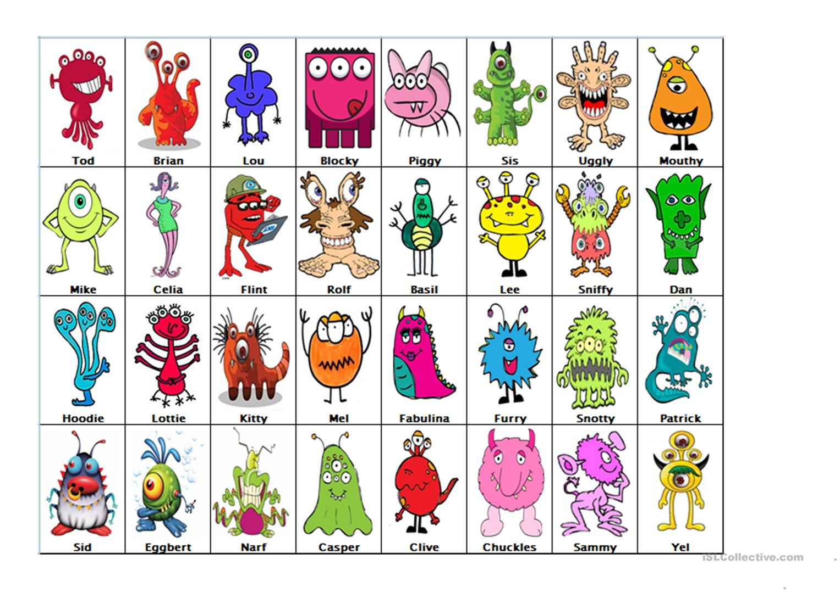
Suspects
Using the information so far, we have managed to create this
list of suspects. Can you help to crack
the remaining codes and rescue Boo?!

Slide 6
Code 1
Letter-Number Cipher

Slide 7
Code 1
Letter-Number Cypher
Question – CLUE
20 8 18 5 5 5 25 5 19
T
H
R
E
E
E
Y
E
S
A | B | C | D | E | F | G | H | I | J | K | L | M | N | O | P | Q | R
1 | 2 | 3 | 4 | 5 | 6 | 7 | 8 | 9 | 10 | 11 | 12 | 13 | 14 | 15 | 16 | 17 | 18
S | T | U | V | W | X | Y | Z
19 | 20 | 21 | 22 | 23 | 24 | 25 | 26

Slide 8
Suspects
Suspects

Slide 9
Suspects
Suspects

Slide 10
Code 2
Dots and Dashes – MORSE CODE

Slide 11
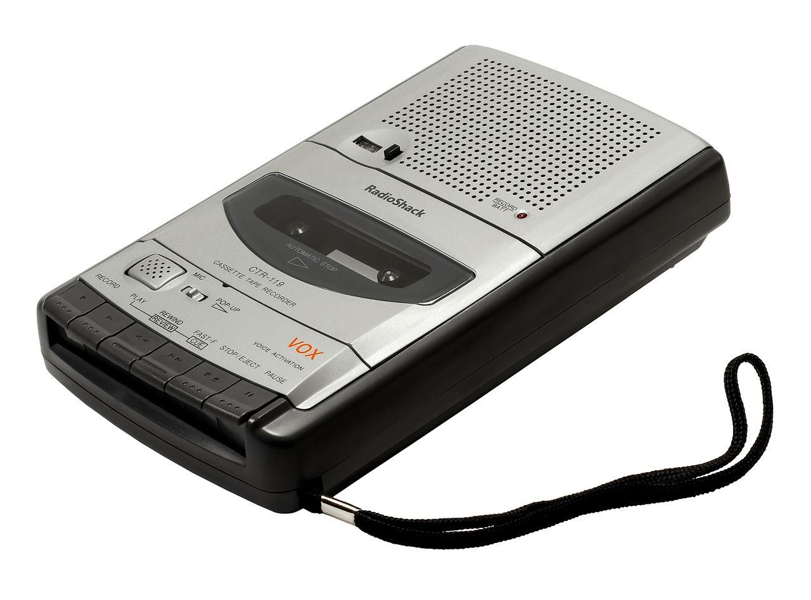
Code 2
Dots and Dashes
We have found a tape featuring a weird message
We think it might contain some sort of code

Slide 12
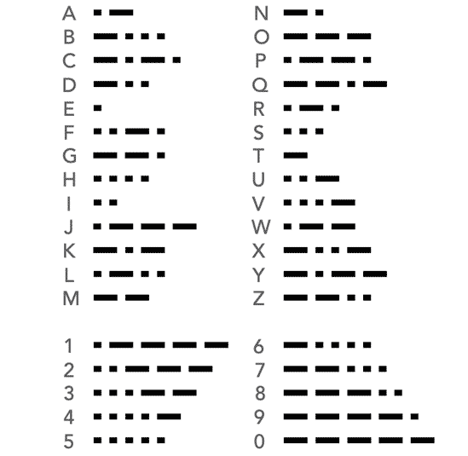
Code 2
Morse Code
CLUE
.. - / .. …. / ._. . _..
Red
It
is

Slide 13
Suspects
Suspects

Slide 14
Suspects
Suspects

Slide 15
Code 3
PHONETIC ALPHABET

Slide 16
Code 3
PHONETIC ALPHABET
We have received a
another message
from Boo
India. Tango
Hotel, Alpha, Sierra
Alpha
Tango, Alpha, India, Lima

Slide 17
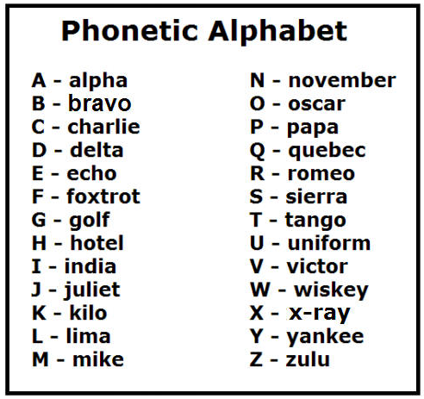
Code 3
PHONETIC ALPHABET
India. Tango
Hotel, Alpha, Sierra
Alpha
Tango, Alpha, India, Lima
IT
HAS
A
TAIL

Slide 18
Suspects
Suspects

Slide 19
Code 4
FLAG SEMAPHORE

Slide 20
Code 4
FLAG SEMAPHORE
A word and Some strange stick figure drawings have been found!
We think it’s another message from Boo...the message is...HAS

Slide 21
Code 4
FLAG SEMAPHORE
F
A
N
G
S

Slide 22
Suspects
Suspects

Slide 23
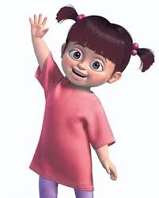
Congratulations!
You have solved the case and managed to rescue Boo!
BOO IS RELEASED!!!

Slide 24
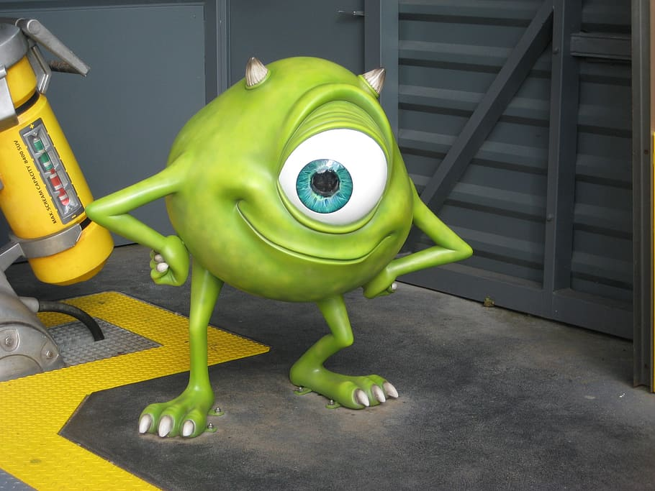
Congratulations!
WELL DONE BEAVERS,
YOU ARE ALL ACE DETECTIVES!!

