Slide 1
BEAVERS
CODE CRACKING
CONTINUES!!!

Slide 2
CODES AND CIPHERS
Cryptography is the use of codes and ciphers to keep information secret. It has been used for thousands of years.
What is the difference between a code and a cipher?
A code affects the word, and a cipher affects the individual letters.

Slide 3
CODES AND CIPHERS
Cryptology is the art and science of making and breaking codes.
Codebreaker is a person who solves secret codes and ciphers without the ‘key’.
Codemaker is a person who makes new secret codes and ciphers

Slide 4
CODES AND CIPHERS
Ciphers is a system to make a word or message secret by changing or rearranging the letters in the message. Example: for example: A=& or A=2.
Code is a system of changing entire words or phrases into something else. Codes are not just secret messages, they can be any symbol or signal used to represent, or communicate, something else. Example: President = Eagle or Tank = 4036

Slide 5
CODES AND CIPHERS
While codes and ciphers are different, the terms are often used interchangeably. Morse code, for example, it technically a cipher, not a code. but it is called Morse code, not Morse cipher.

Slide 6
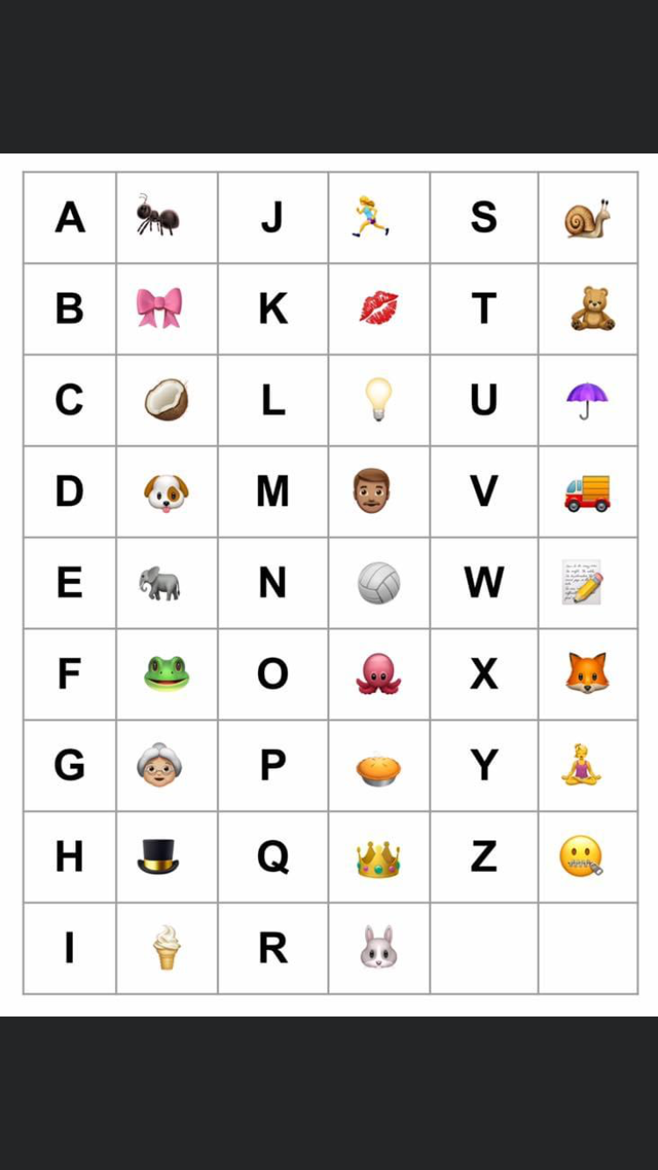
PICTURE CIPHERS
Using the picture KEY on the right solve the clue!
F
R
O
G
YOU MIGHT BE ABLE TO SOLVE THIS ONE WITHOUT THE KEY - FIRST LETTERS OF EACH PICTURE ARE THE SAME AS THE LETTER

Slide 7
PICTURE CIPHERS
BUT NOT WITH THIS ONE! YOU NEED THE KEY TO SOLVE
R
I
C
E

Slide 8
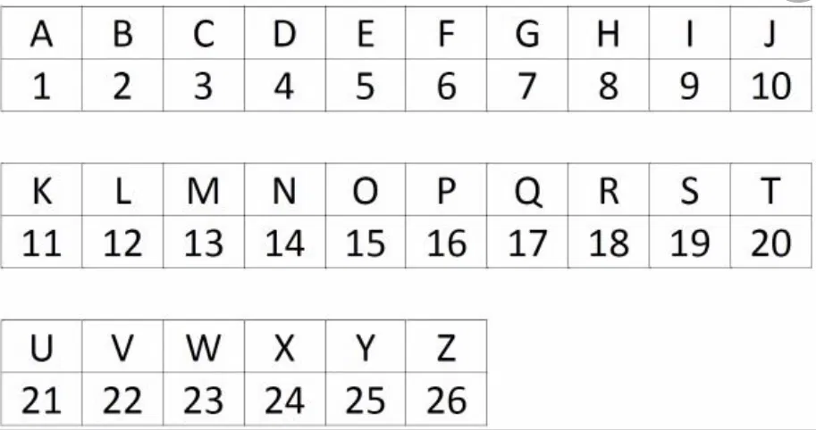
LETTER TO NUMBER CIPHERS
11
K
I
9
20
T
THE KEY TO SOLVE
5
E

Slide 9
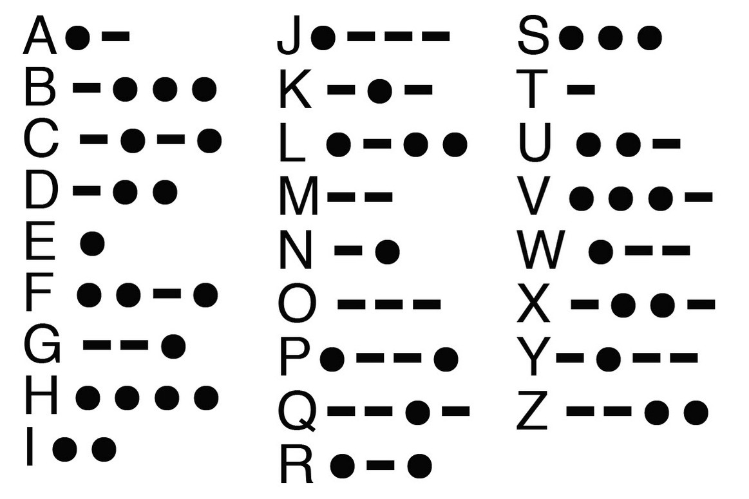
MORSE CODE
…. --- .--
/ -.-. --- --- .-..
HOW
COOL

Slide 10
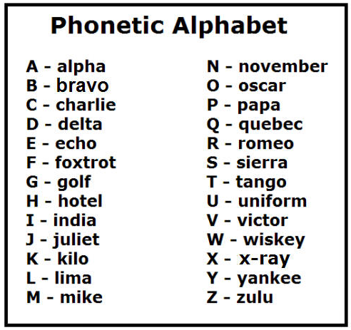
PHONETIC ALPHABET
INDIA,SIERRA
TANGO,HOTEL,INDIA,SIERRA
IS
THIS

Slide 11
NOW SOMETHING A LITTLE DIFFERENT
Flag semaphore - is an alphabet signalling system based on the waving of a pair of hand-held flags (or lights sticks held in hands) in a particular pattern. It is still widely used today!

Slide 12
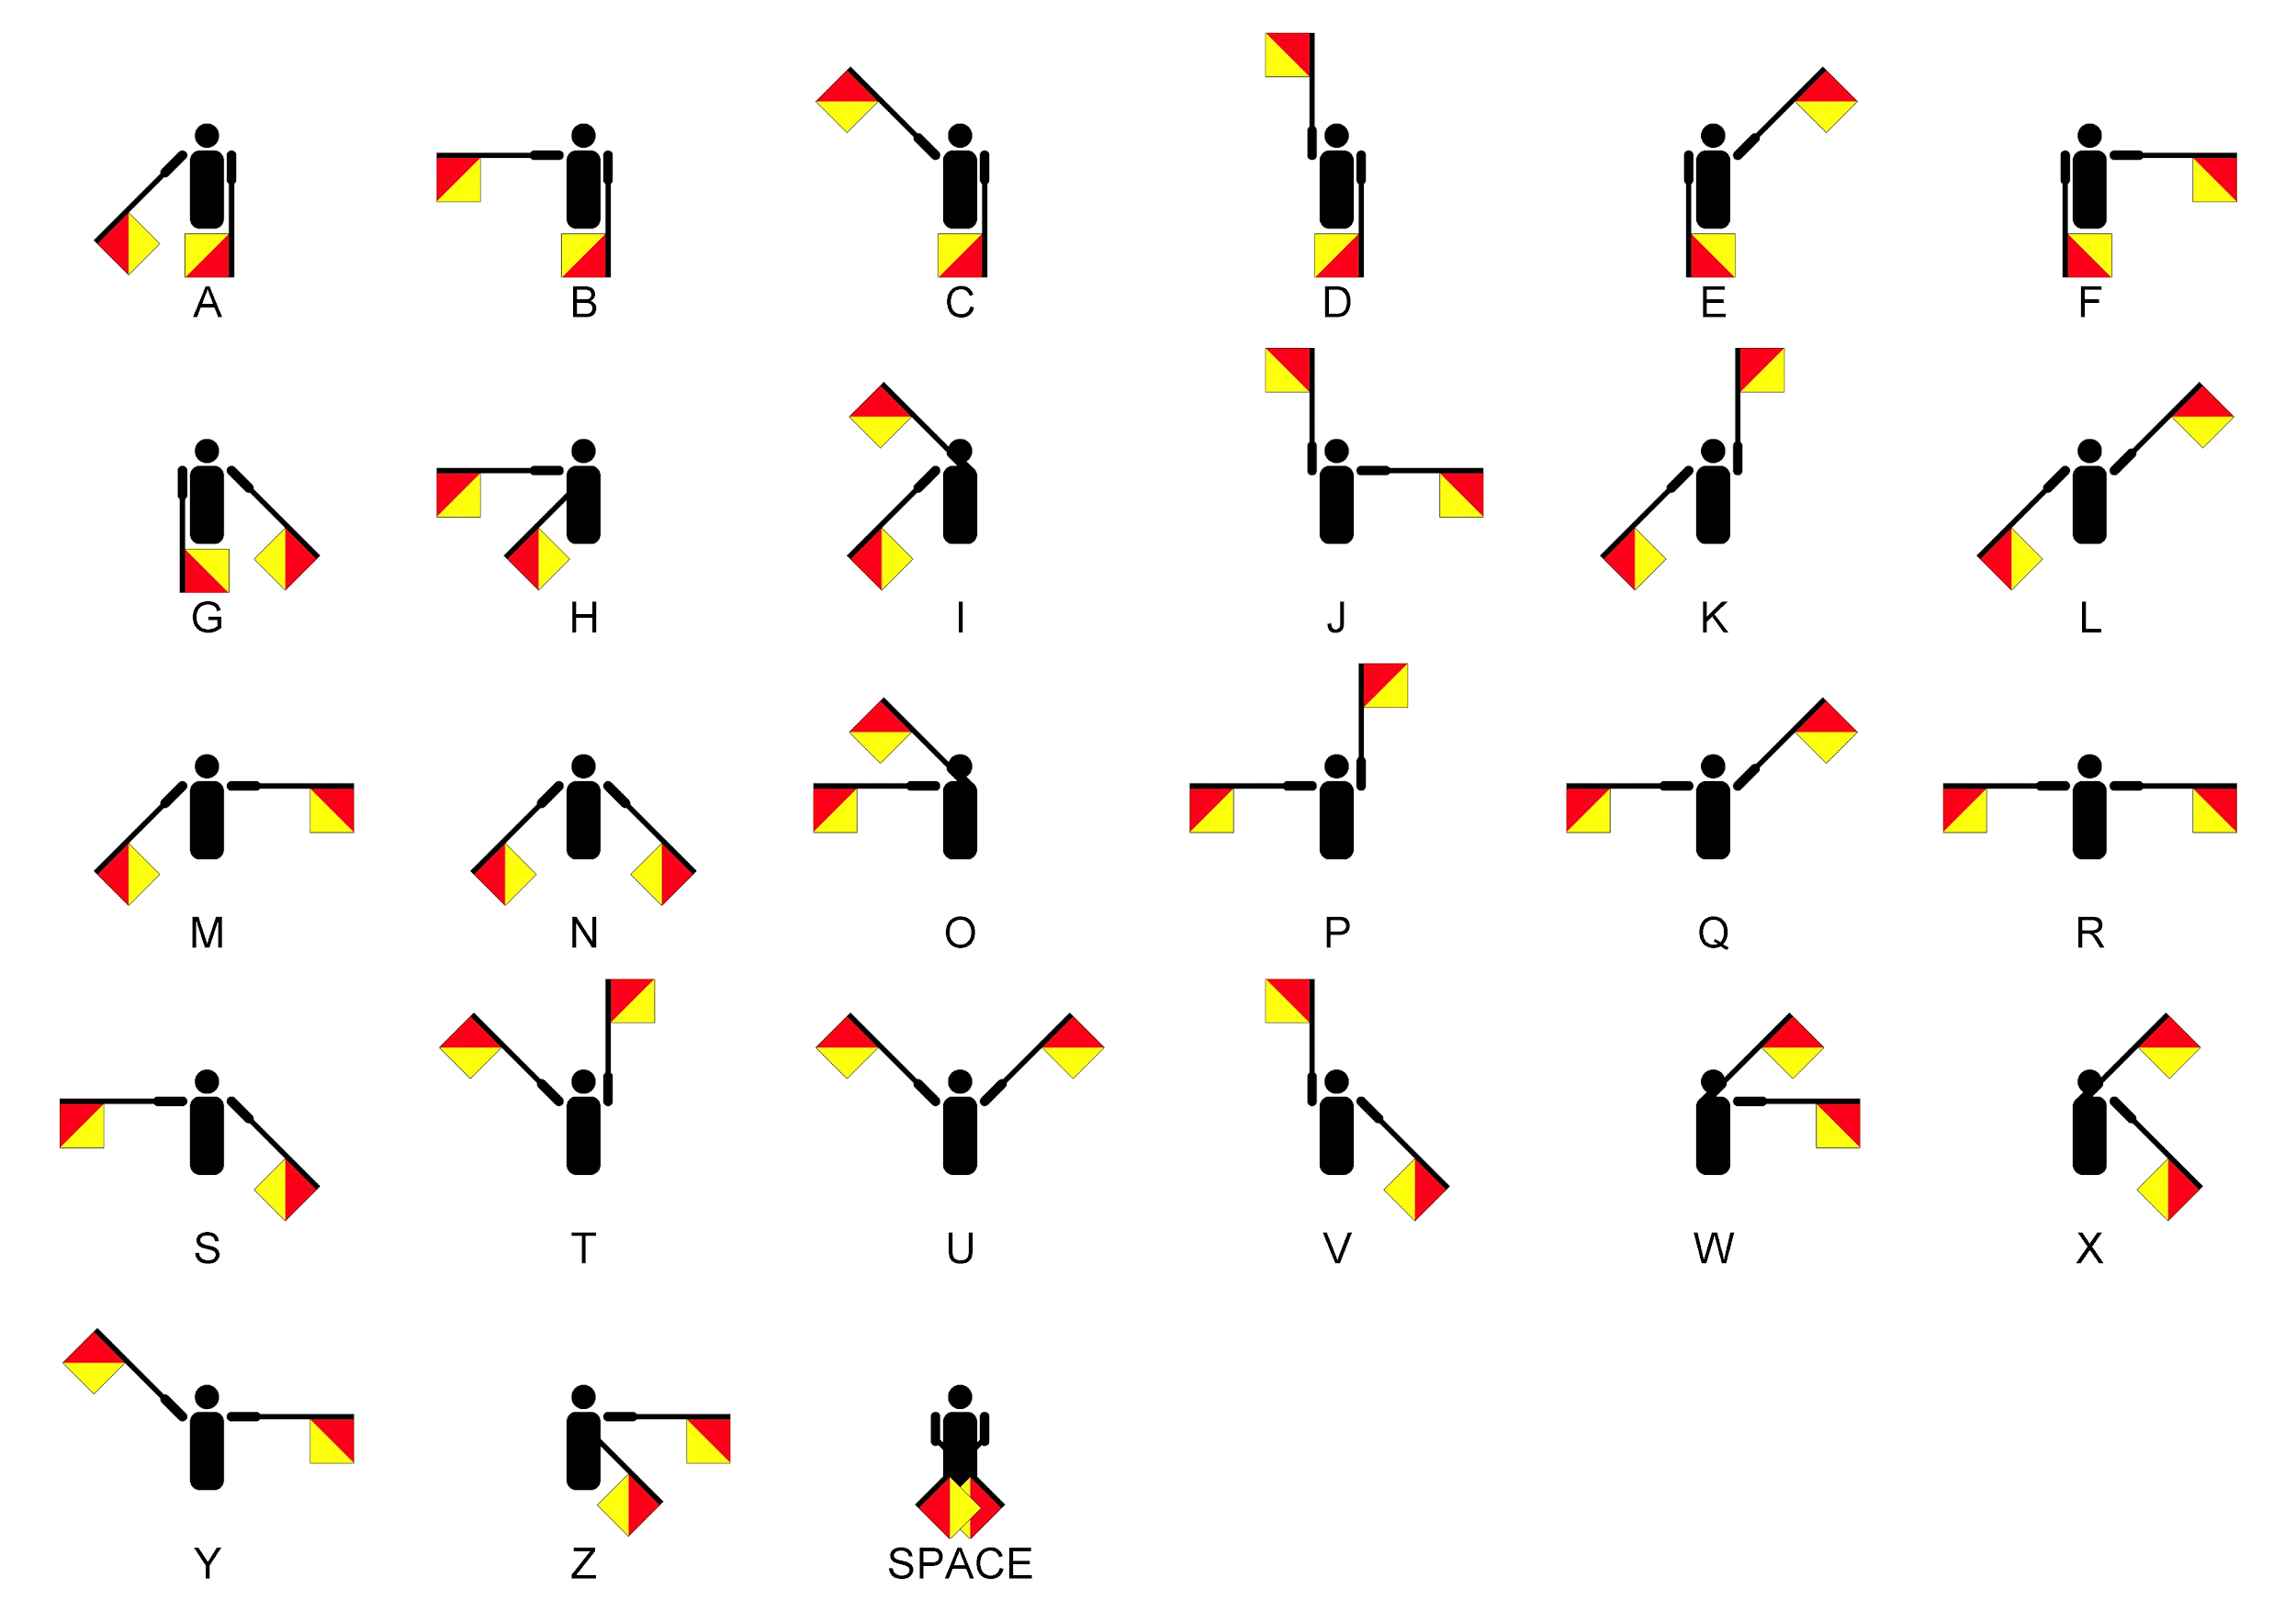
Flag semaphore
E
N
D

Slide 13
Reference;
https://ext.vt.edu/content/dam/ext_vt_edu/topics/4h-youth/makers/files/ww1-science-behind-it-codes-ciphers.pdf
1st virtual scout group https://www.facebook.com/groups/208981546868424/

