Slide 2
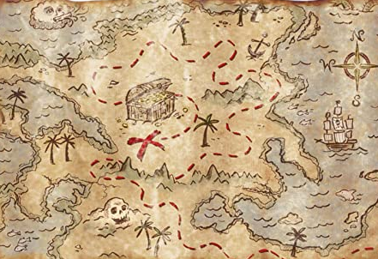
You are a group of Pirates who found a treasure map and travelled across the ocean to Pirate Island in search of the hidden treasure!

Slide 3
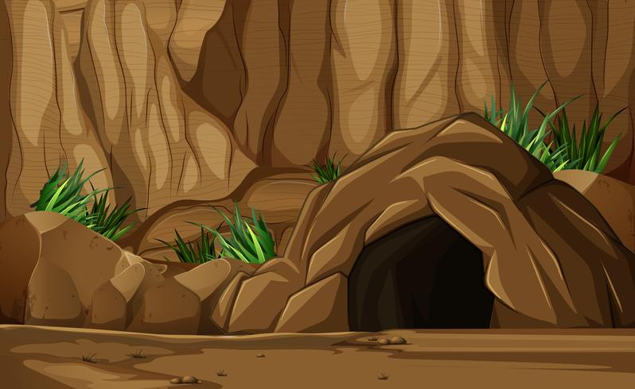
The map has led you to a dark cave, you can see something glowing inside...

Slide 4
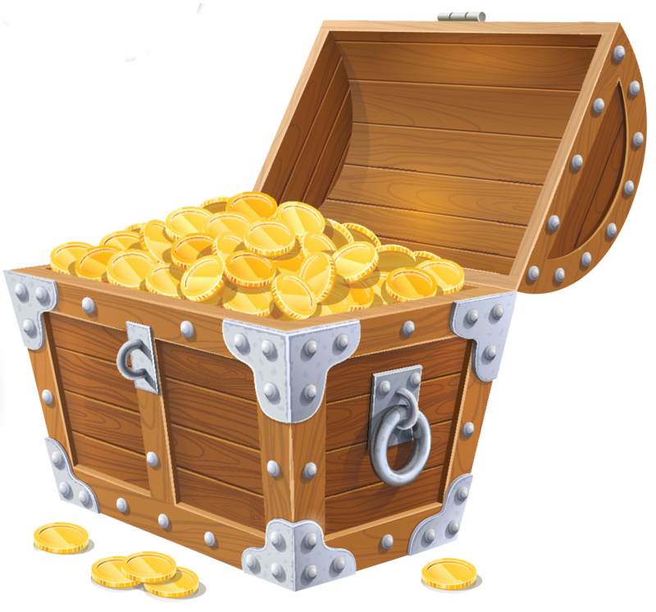
You enter the cave and find a treasure chest! You open it carefully, the treasure glows brightly.

Slide 5
But suddenly a door slams shut across the mouth of the cave!
You’re thrown into darkness...

Slide 7
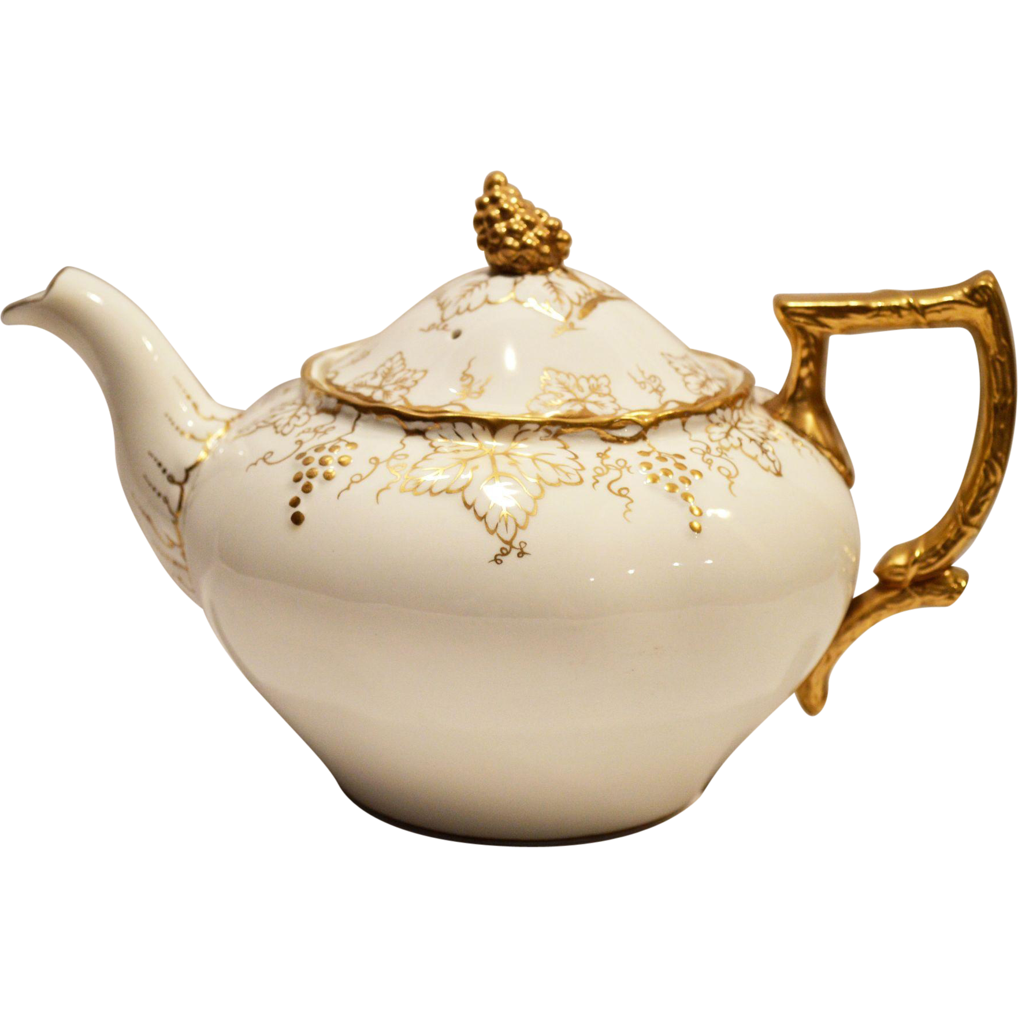
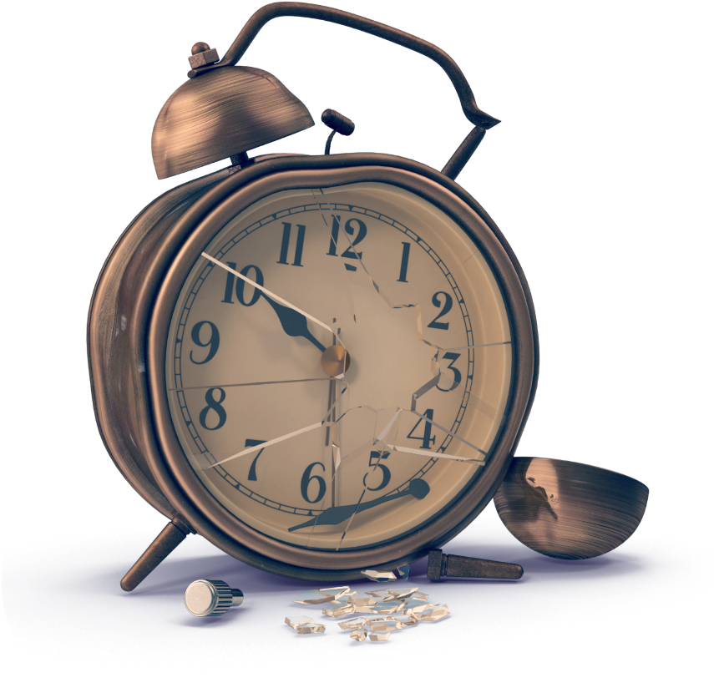
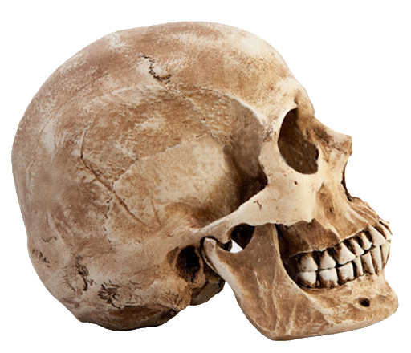
You light your torches and start searching around the cave. The heavy wooden door is locked tight with 4 different locks - 2 need keys and 2 are padlocks with codes. You also spot a dusty old book, a broken clock, a teapot and a skull!

Slide 8
You open the book and begin to read…..

Slide 9
Congratulations you found my treasure,
But locked in here you’ll stay forever.
Unless you can solve these clues real fast,
The locks won’t open, your torches won’t last.
So turn the page and begin your quest,
Pirates you must try your best!

Slide 10
Clue number 1…
The first clue is easy, you’ll find it a diddle, all you need to do is solve this riddle…
I have hands but cannot clap
What am I?

Slide 11
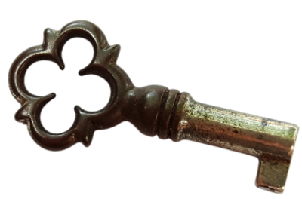
You pick up the clock and find a door in the back. You open it to reveal a rusty old key! You try it in the first lock and it opens - well done! You return to the book and read on...

Slide 12
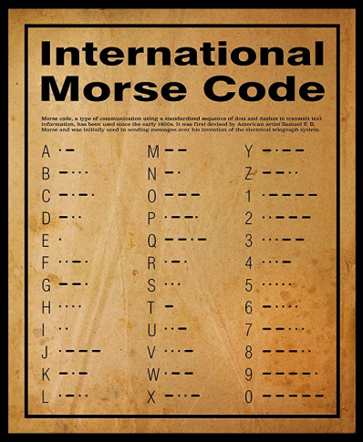
Clue number 2…
Can you find the number code for lock number 2?
..._ _
_ ….
_ _ _ _ .
. _ _ _ _

Slide 13
Clue number 2…
Can you find the number code for lock number 2?
..._ _
3
_ ….
_ _ _ _ .
. _ _ _ _

Slide 14
Clue number 2…
Can you find the number code for lock number 2?
..._ _
3
_ ….
6
_ _ _ _ .
. _ _ _ _

Slide 15
Clue number 2…
Can you find the number code for lock number 2?
..._ _
3
_ ….
6
_ _ _ _ .
9
. _ _ _ _

Slide 16
Clue number 2…
Can you find the number code for lock number 2?
..._ _
3
_ ….
6
_ _ _ _ .
9
. _ _ _ _
1

Slide 17
You enter the code in the padlock...

Slide 18
You enter the code in the padlock...
3

Slide 19
You enter the code in the padlock...
3
6

Slide 20
You enter the code in the padlock...
3
6
9

Slide 21
You enter the code in the padlock...
3
6
9
1

Slide 22
Congratulations you opened the lock!
Just 2 locks to go.
You return to the book...
3
6
9
1

Slide 23
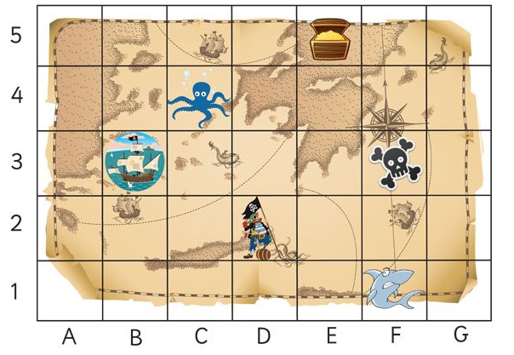
Clue number 3…
Find what object is in these coordinates:
F1 _ _ _ _ _
C4 _ _ _ _ _ _ _
E5 _ H _ _ _
B3 _ _ _ P
Use the first letter from each word to open the lock!
_ _ _ _

Slide 24
Clue number 3…
Find what object is in these coordinates:
F1 SHARK
C4 _ _ _ _ _ _ _
E5 _ H _ _ _
B3 _ _ _ P
Use the first letter from each word to open the lock!
S _ _ _

Slide 25
Clue number 3…
Find what object is in these coordinates:
F1 SHARK
C4 OCTOPUS
E5 _ H _ _ _
B3 _ _ _ P
Use the first letter from each word to open the lock!
S O _ _

Slide 26
Clue number 3…
Find what object is in these coordinates:
F1 SHARK
C4 OCTOPUS
E5 CHEST
B3 _ _ _ P
Use the first letter from each word to open the lock!
S O C _

Slide 27
Clue number 3…
Find what object is in these coordinates:
F1 SHARK
C4 OCTOPUS
E5 CHEST
B3 SHIP
Use the first letter from each word to open the lock!
S O C S

Slide 28
You enter the code in the other padlock...

Slide 29
You enter the code in the other padlock...
S

Slide 30
You enter the code in the other padlock...
S
O

Slide 31
You enter the code in the other padlock...
S
O
C

Slide 32
You enter the code in the other padlock...
S
O
C
S

Slide 33
Congratulations you opened the 3rd lock!
Only 1 left.
You return to the book...
S
O
C
S

Slide 34
Clue number 4…
You’re almost there, you’re doing well, another riddle would be just swell!
What starts with t, ends with t
and has t in it?

Slide 35
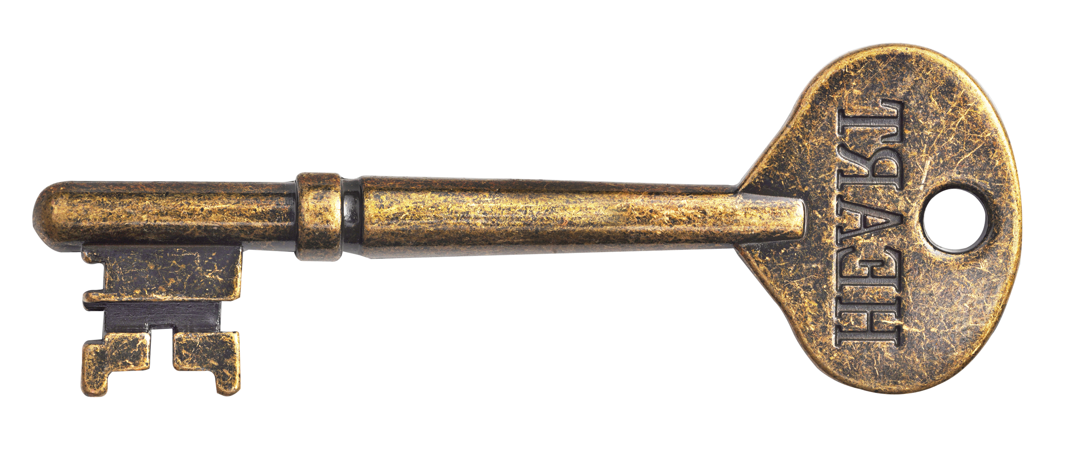
You look inside the teapot and find another key. It fits the 4th lock, hurray!
But the door will not open.You return to the book…

Slide 36
Arrrr me hearties
You thought your escape was done, but the truth is I wanted to have some more fun!
Solve one more clue and you’re free with my gold.
But fail this task and in here you’ll grow old...
Follow the map and compass instructions and collect some letters. Unjumble these to discover the secret password!
Call it out to open the door...

Slide 37
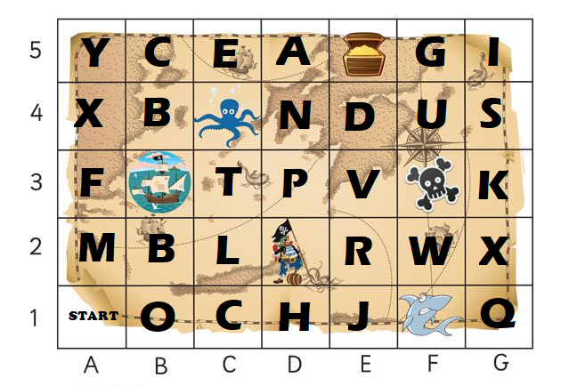
Clue number 5…
Start in A1
Go North 4 squares and collect the letter
Go East 3 squares and collect the letter
Go South 4 squares and collect the letter
Go West 2 squares and collect the letter
_ _ _ _

Slide 38
Clue number 5…
Start in A1
Go North 4 squares and collect the letter
Go East 3 squares and collect the letter
Go South 4 squares and collect the letter
Go West 2 squares and collect the letter
Y _ _ _

Slide 39
Clue number 5…
Start in A1
Go North 4 squares and collect the letter
Go East 3 squares and collect the letter
Go South 4 squares and collect the letter
Go West 2 squares and collect the letter
Y A _ _

Slide 40
Clue number 5…
Start in A1
Go North 4 squares and collect the letter
Go East 3 squares and collect the letter
Go South 4 squares and collect the letter
Go West 2 squares and collect the letter
Y A H _

Slide 41
Clue number 5…
Start in A1
Go North 4 squares and collect the letter
Go East 3 squares and collect the letter
Go South 4 squares and collect the letter
Go West 2 squares and collect the letter
Y A H O

Slide 42
You call out AHOY as loud as you can after 3….
1…2…3...

Slide 43
The door opens and you’re free! Congratulations Pirates you’ve escaped with the treasure!

Slide 44
The door opens and you’re free! Congratulations Pirates you’ve escaped with the treasure!

