Slide 1
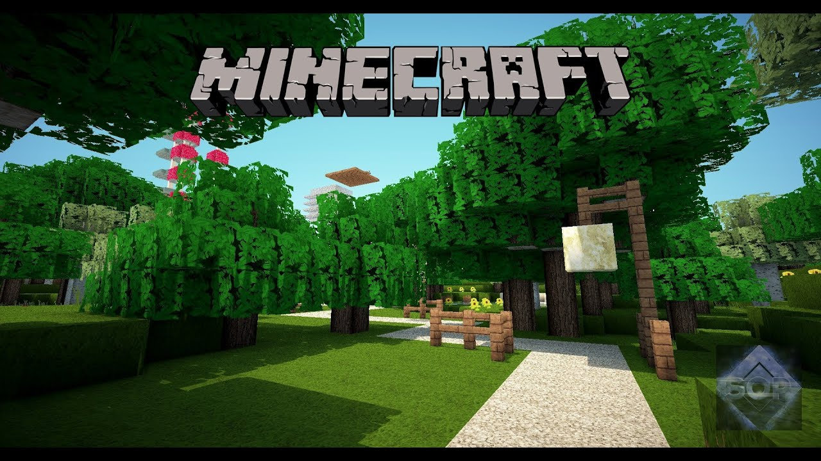
QUIZ

Slide 2
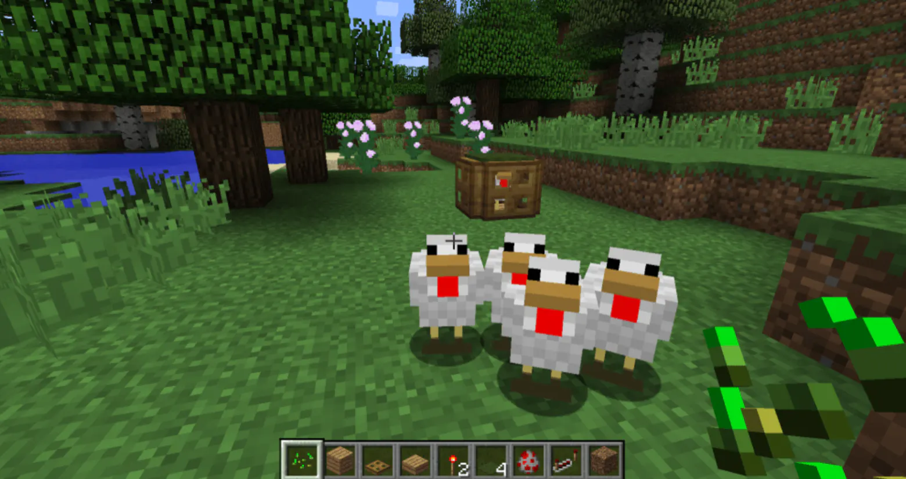
What is it called when you first enter the Minecraft world?
YAWNING,
BIRTHING,
SPAWNING OR
DAWNING

Slide 3
What are the four elements in Minecraft?
FIRE, EARTH, WATER & AIR

Slide 4
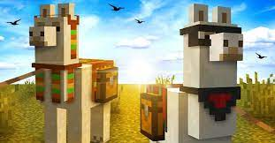
What do Llamas eat in Minecraft ?
HAY BALES, PUMPKIN SEEDS or BERRIES

Slide 5
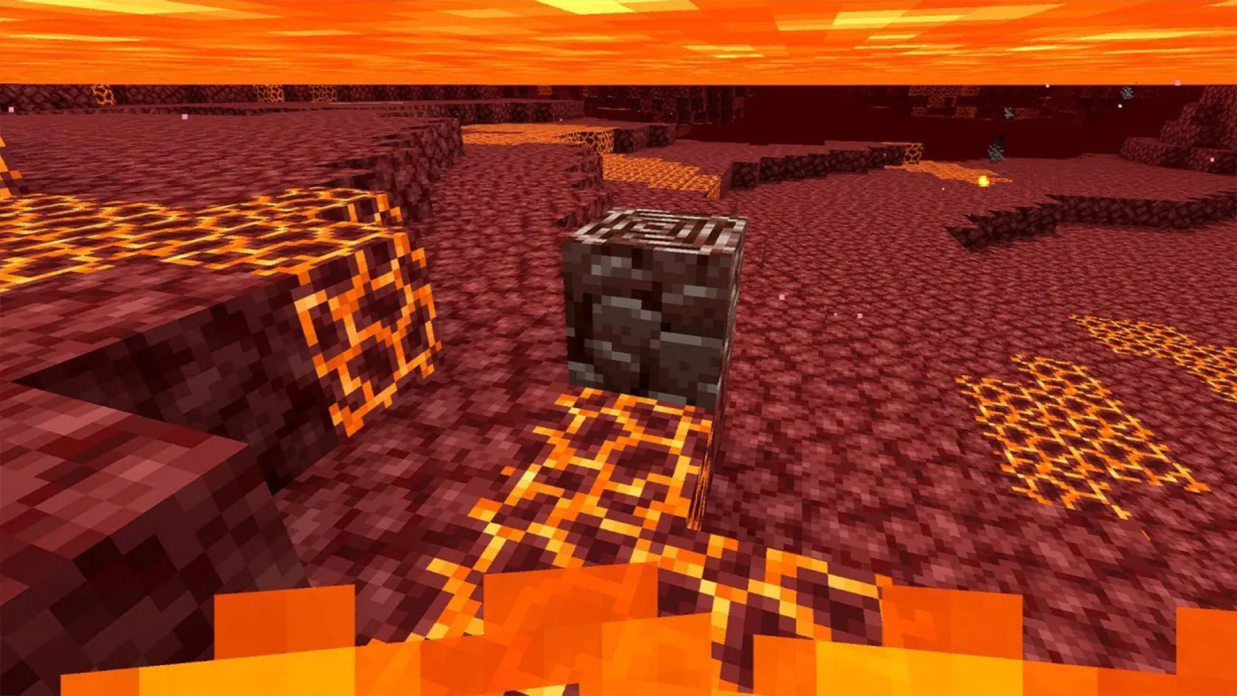
Where is this?
THE DESERT, A VOLACNO, THE NETHER

Slide 6
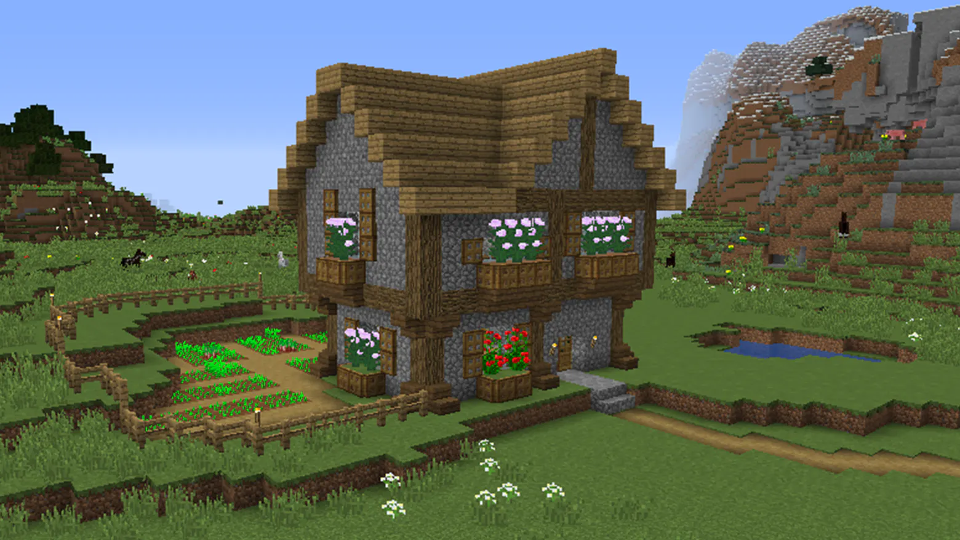
Would you build a house in Creative or Survival Mode?
CREATIVE

Slide 7
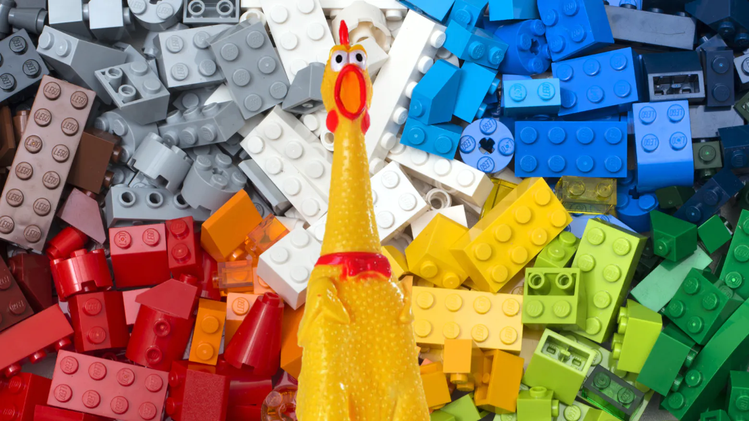
Name this real BLOCK BUILDING TOY?
LEGO

Slide 8
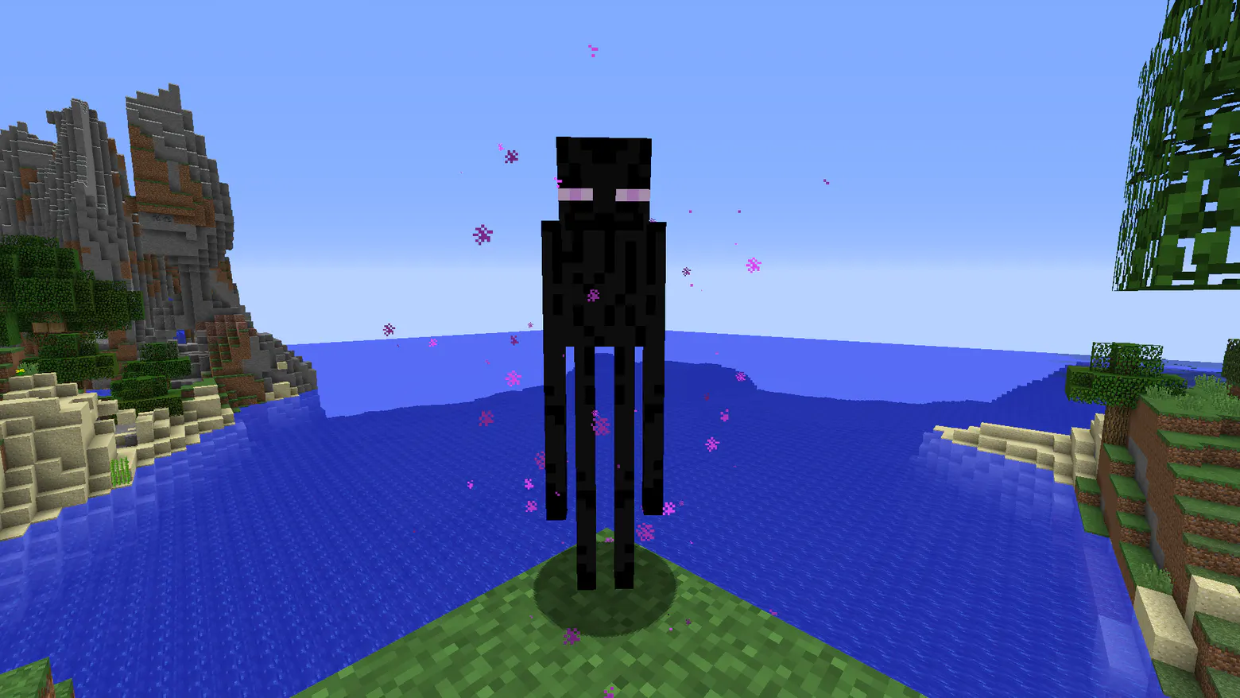
This is an “ENDERMAN” but how do you damage it?
WATER

Slide 9
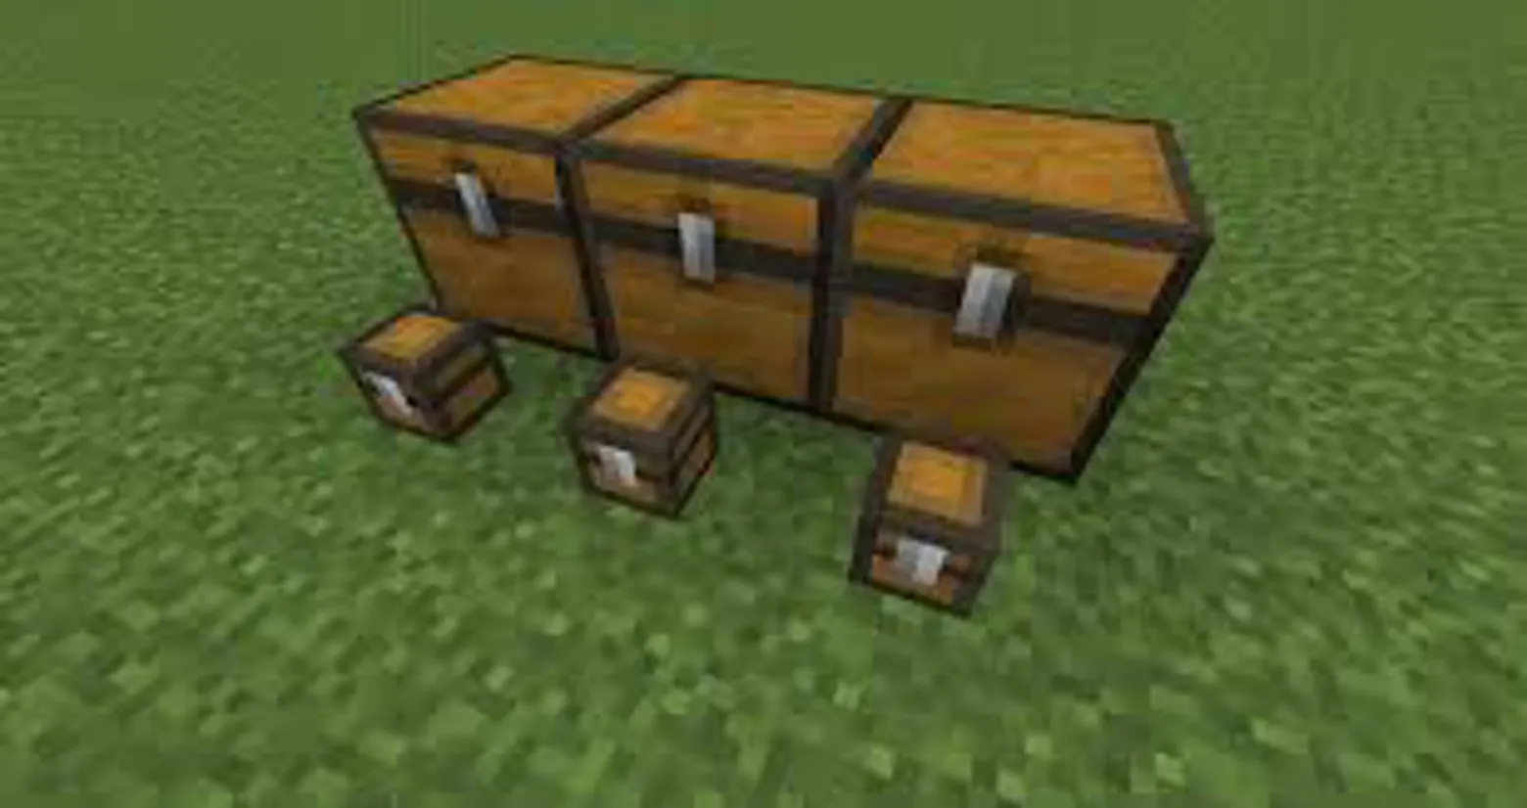
How do you make a LARGE Chest?
Put 2 next to each other!

Slide 10
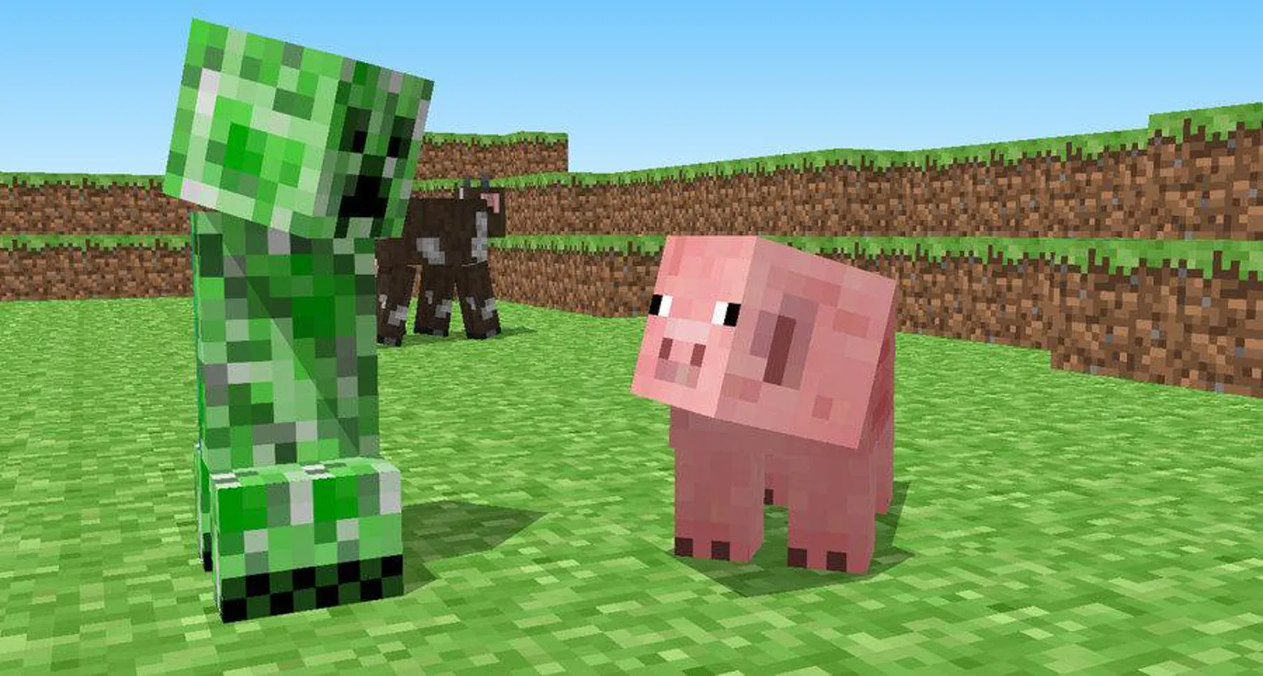
What are Creepers Scared of?
OCELOTS (Cats)

Slide 11
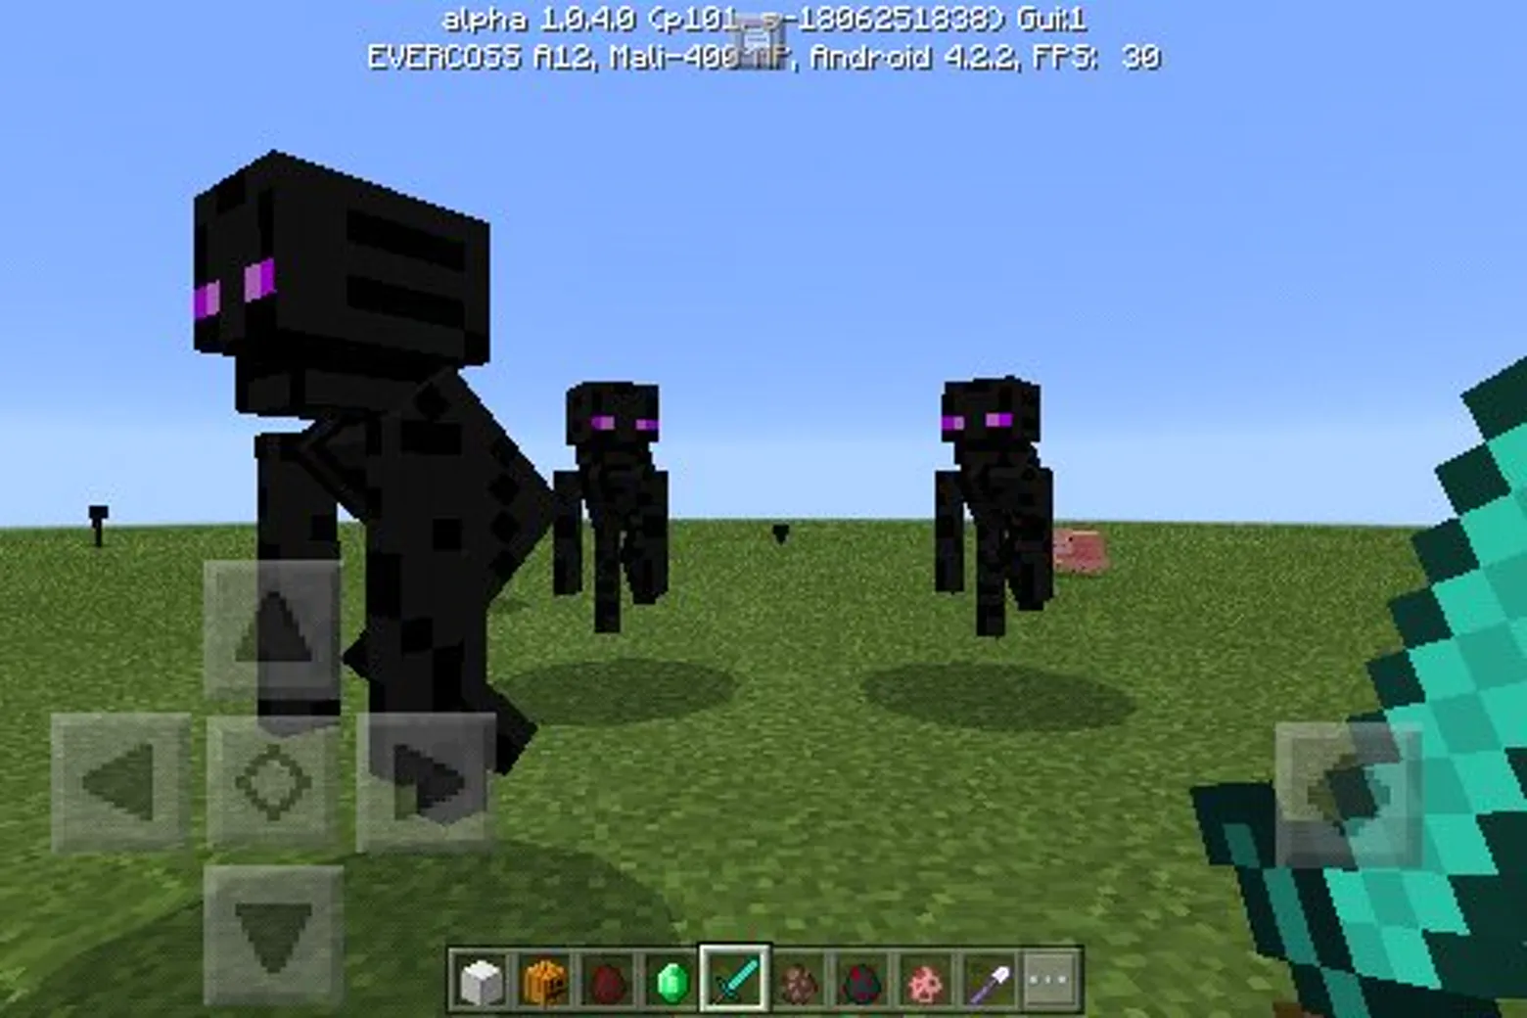
What can you wear to stop ENDERMAN attacking you?
PUMPKIN

Slide 12
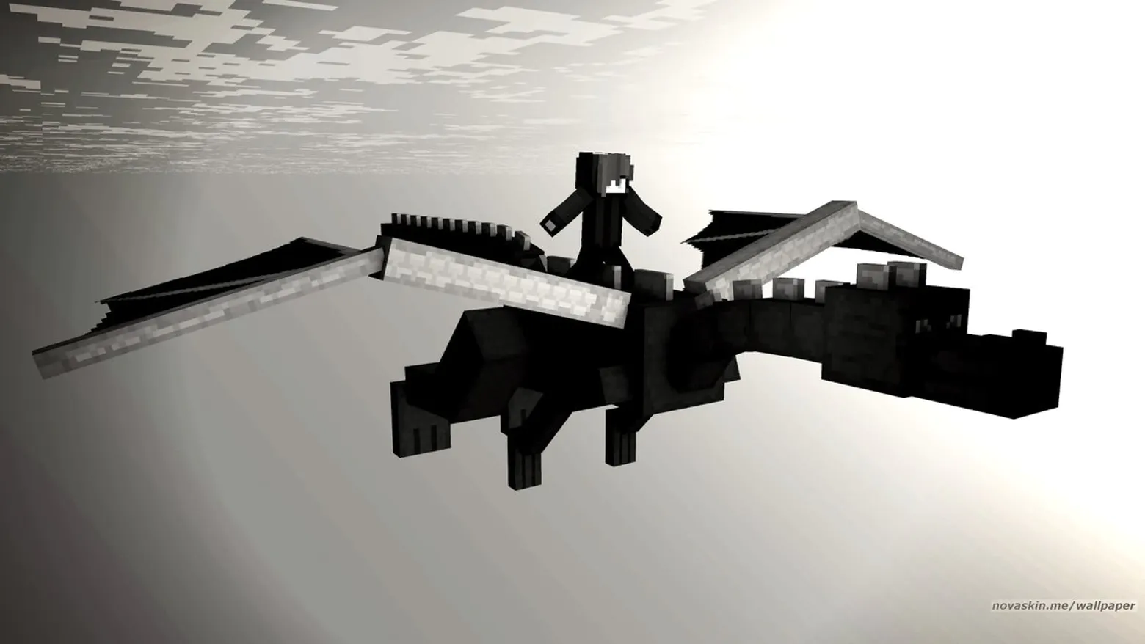
Who is the leader of the ENDERMEN?
ENDER DRAGON

Slide 13
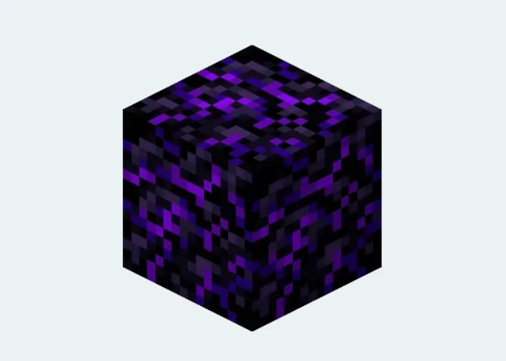
How do you make OBSIDIAN?
MIX WATER & LAVA

Slide 14
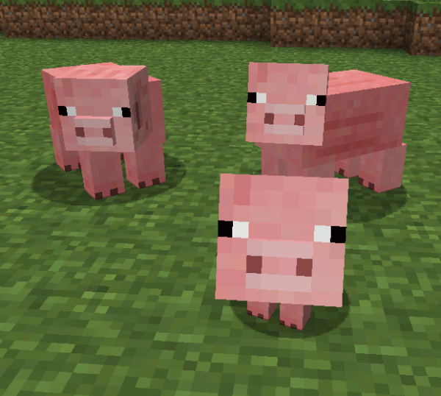
What do Pigs eat in Minecraft?
CARROTS, APPLES OR WHEAT

Slide 15
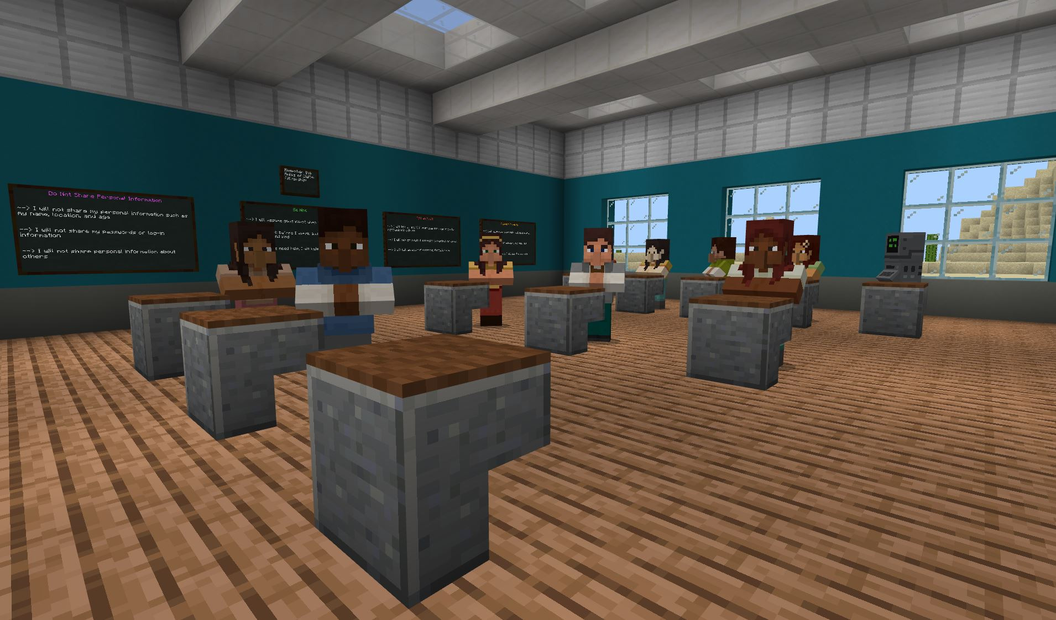
Minecraft is part of the educational curriculum in which of the following?
PLAY SCHOOL, PRIMARY SCHOOL OR UNIVERSITY

Slide 16
Which Country is Mojang based in?

Slide 17
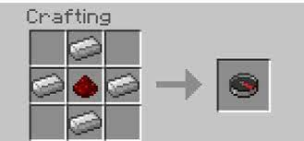
What do you need to make a compass?
Two Iron ingots and a map
Or
Four iron ingots and one redstone.

Slide 18
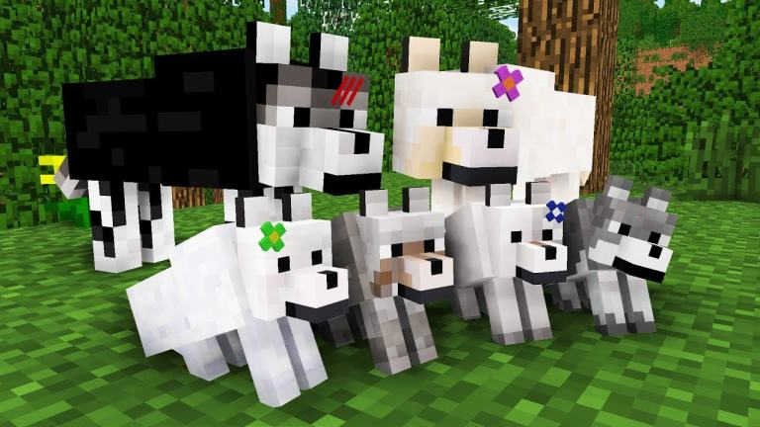
How do you tame a Wolf?
You feed it bones
Or
Play it relaxing music??

Slide 19
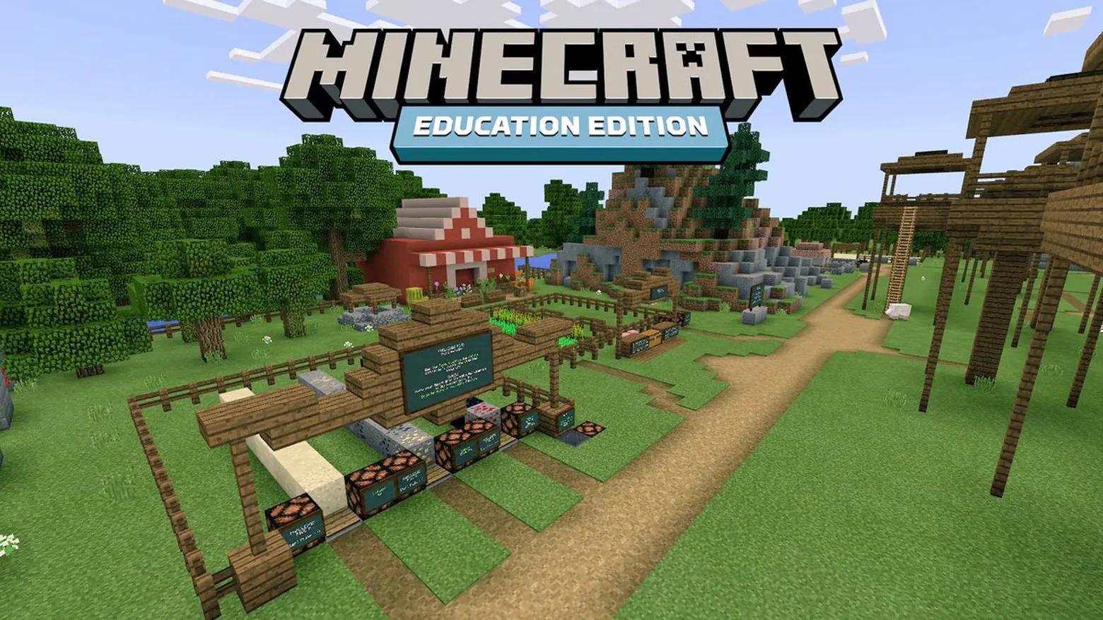
In which county do they let you plan MINECRAFT at school?
Sweden
Norway
France
Japan

Slide 20
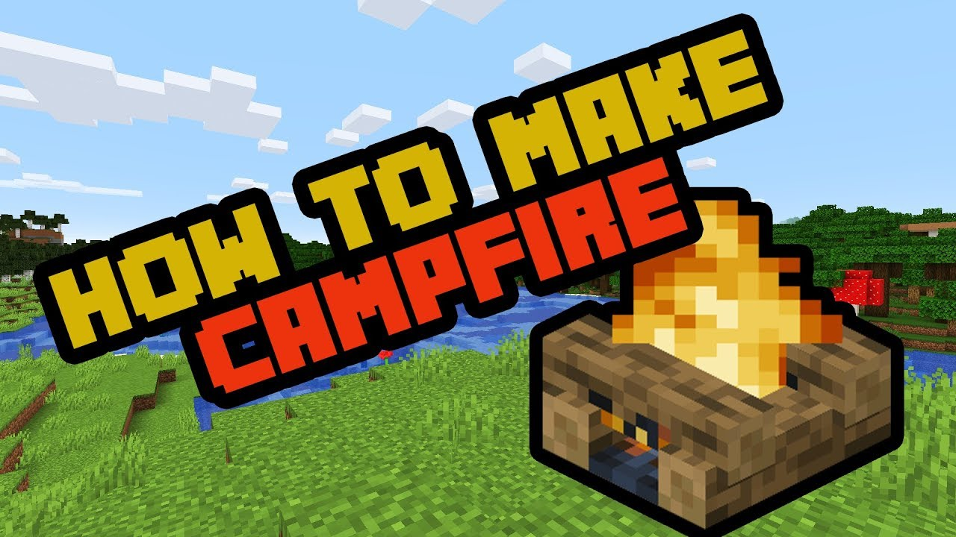
We would like you all to make a campfire using your choice of materials: lego, blocks, modeling clay, nature, food, drawing, painting, models and even building in Minecraft and showing us all next week. Have a great time creating Beavers

